Slide 1



The Saboteur in Your Retrospectives
How Your Brain Works Against You
Arthur Doler
@arthurdoler
arthurdoler@gmail.com
Slides: http://bit.ly/2vttrTx
Handout: http://bit.ly/2viy7en
Notes:
Slide links

Slide 2



































TITANIUM SPONSORS
Platinum Sponsors
Gold Sponsors

Slide 3
Why should we have Retrospectives?

Slide 4
To assess the outcomes of the team’s behavior To change that behavior to get better outcomes

Slide 5
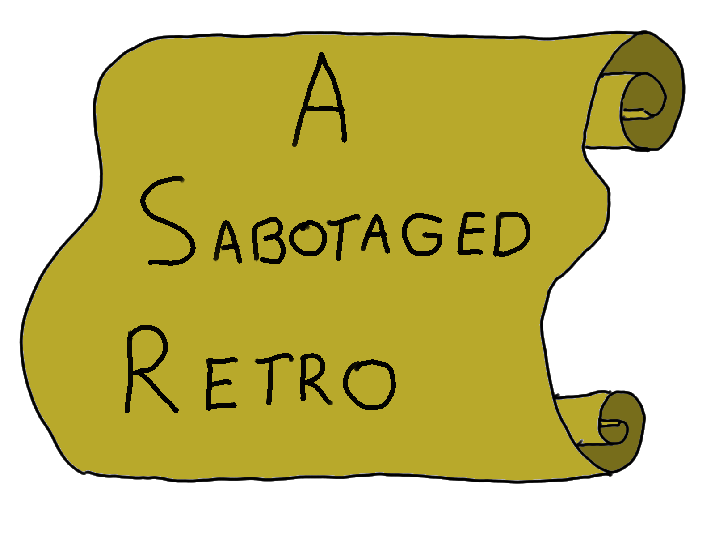

Slide 6
What happened?!

Slide 7
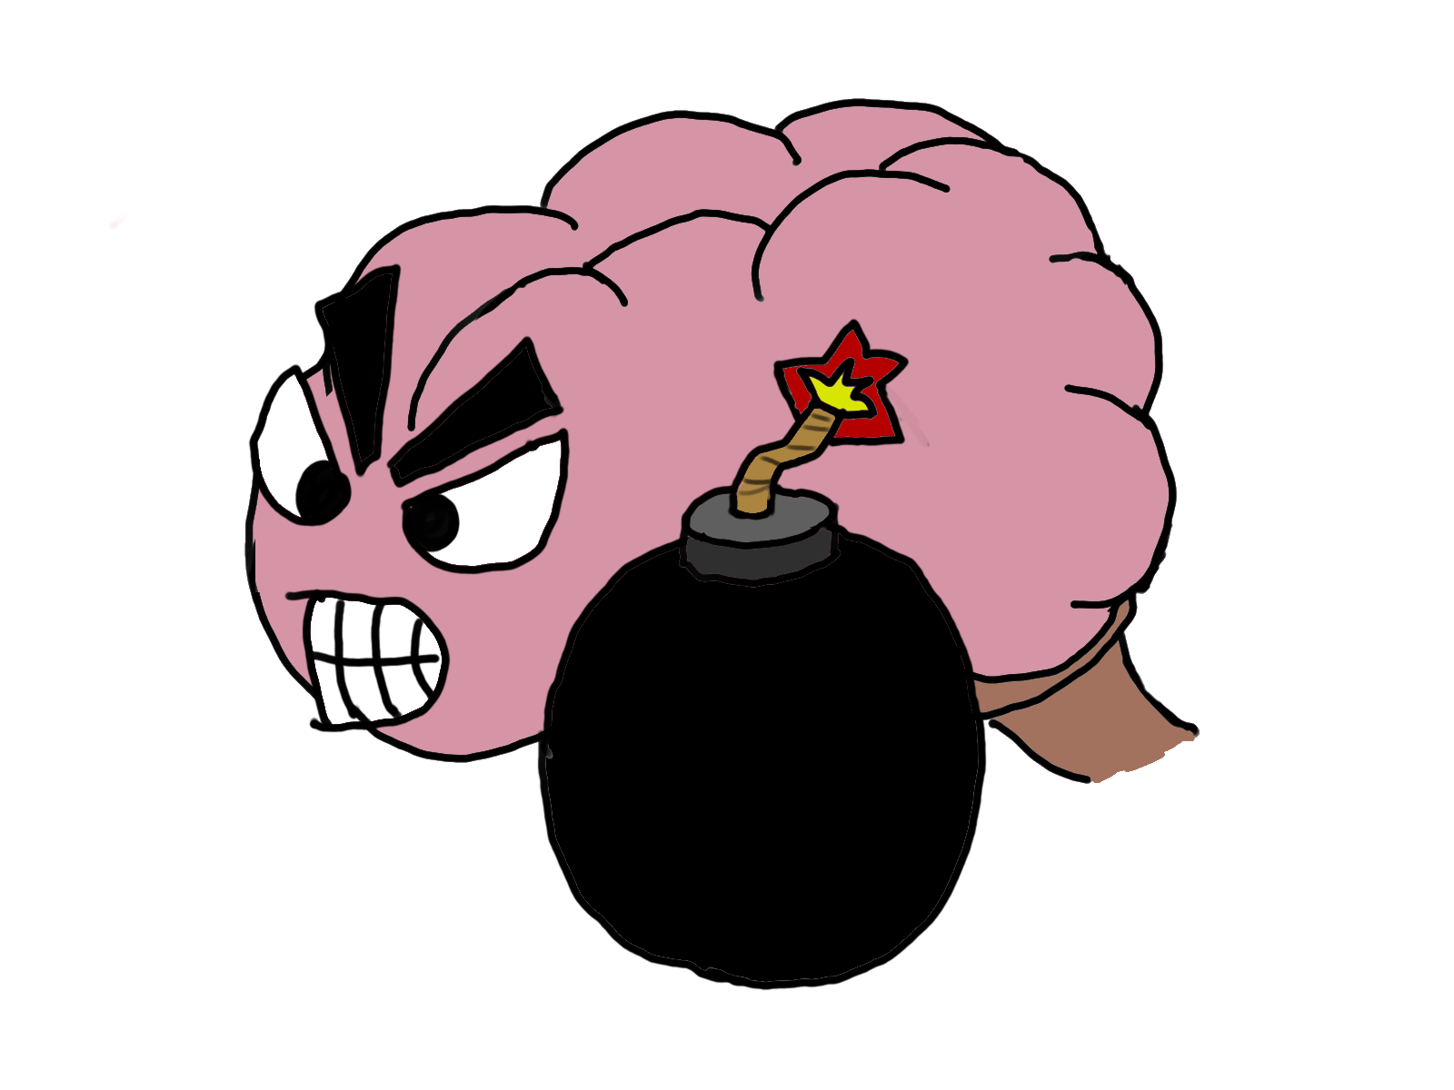

Slide 8
The BRAIN happened!
Cognitive Biases

Slide 9
system 1 system 2

Slide 10
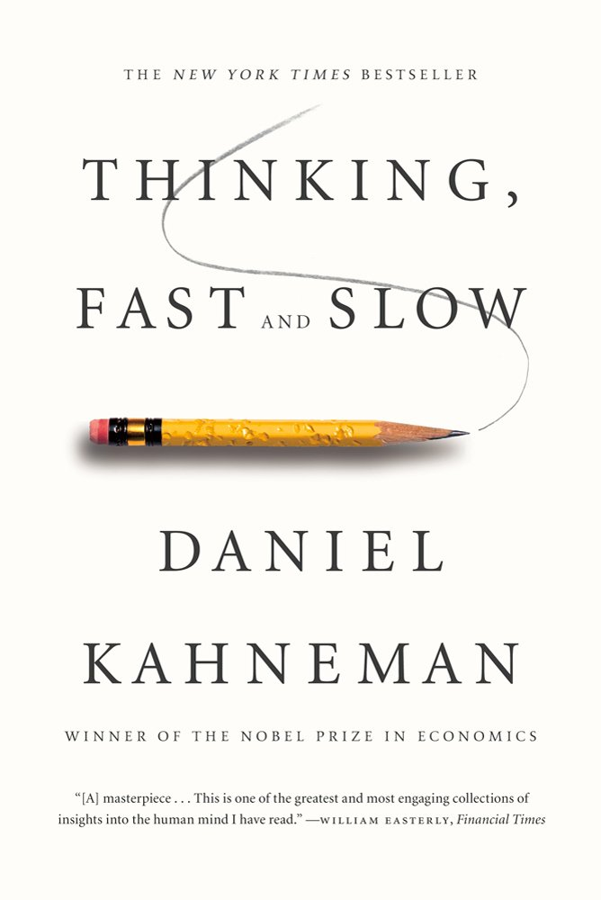
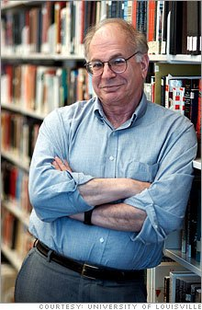

Slide 11
Cognitive
Conscious
Linear
System 2
Intuitive
Unconscious
Associative
System 1

Slide 12
Personifying the systems helps us reason about their actions better (that’s agent bias)

Slide 13
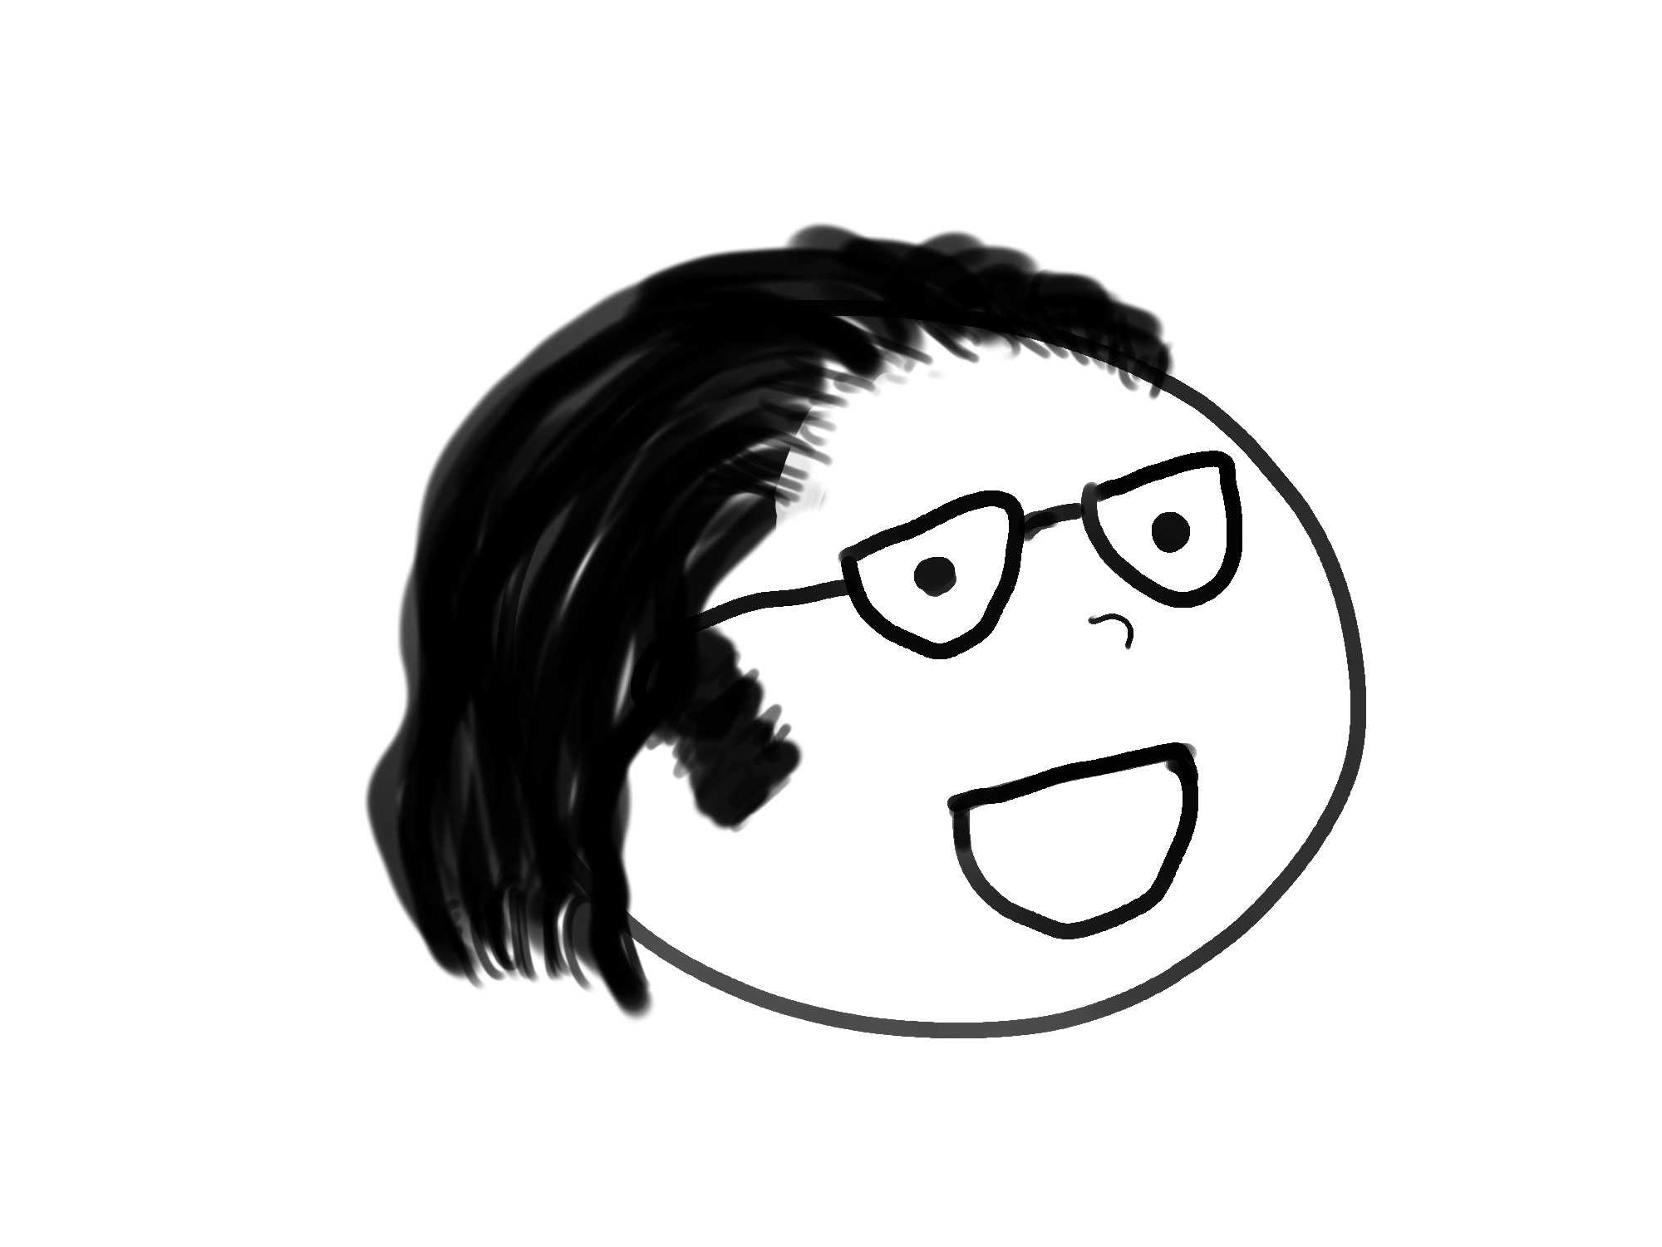
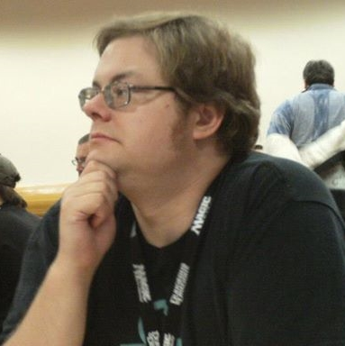
System 2
(Me)

Slide 14
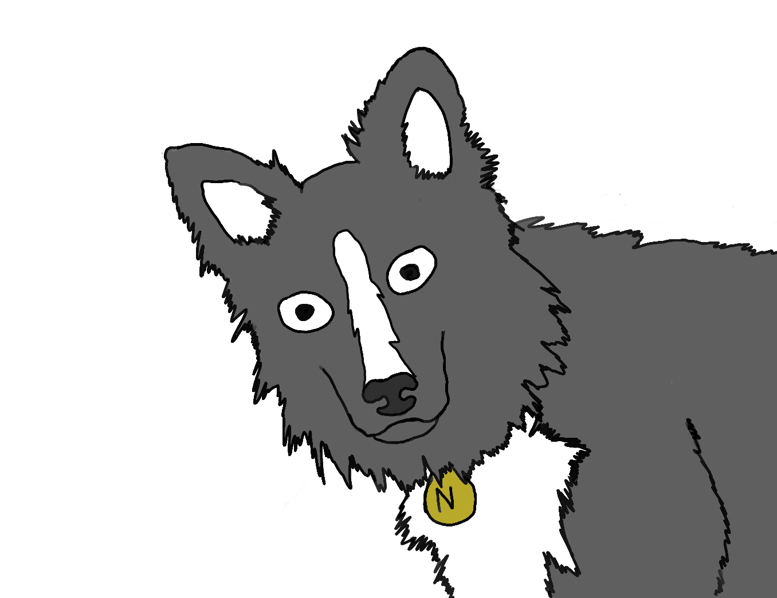
System 1
(Noodles)

Slide 15
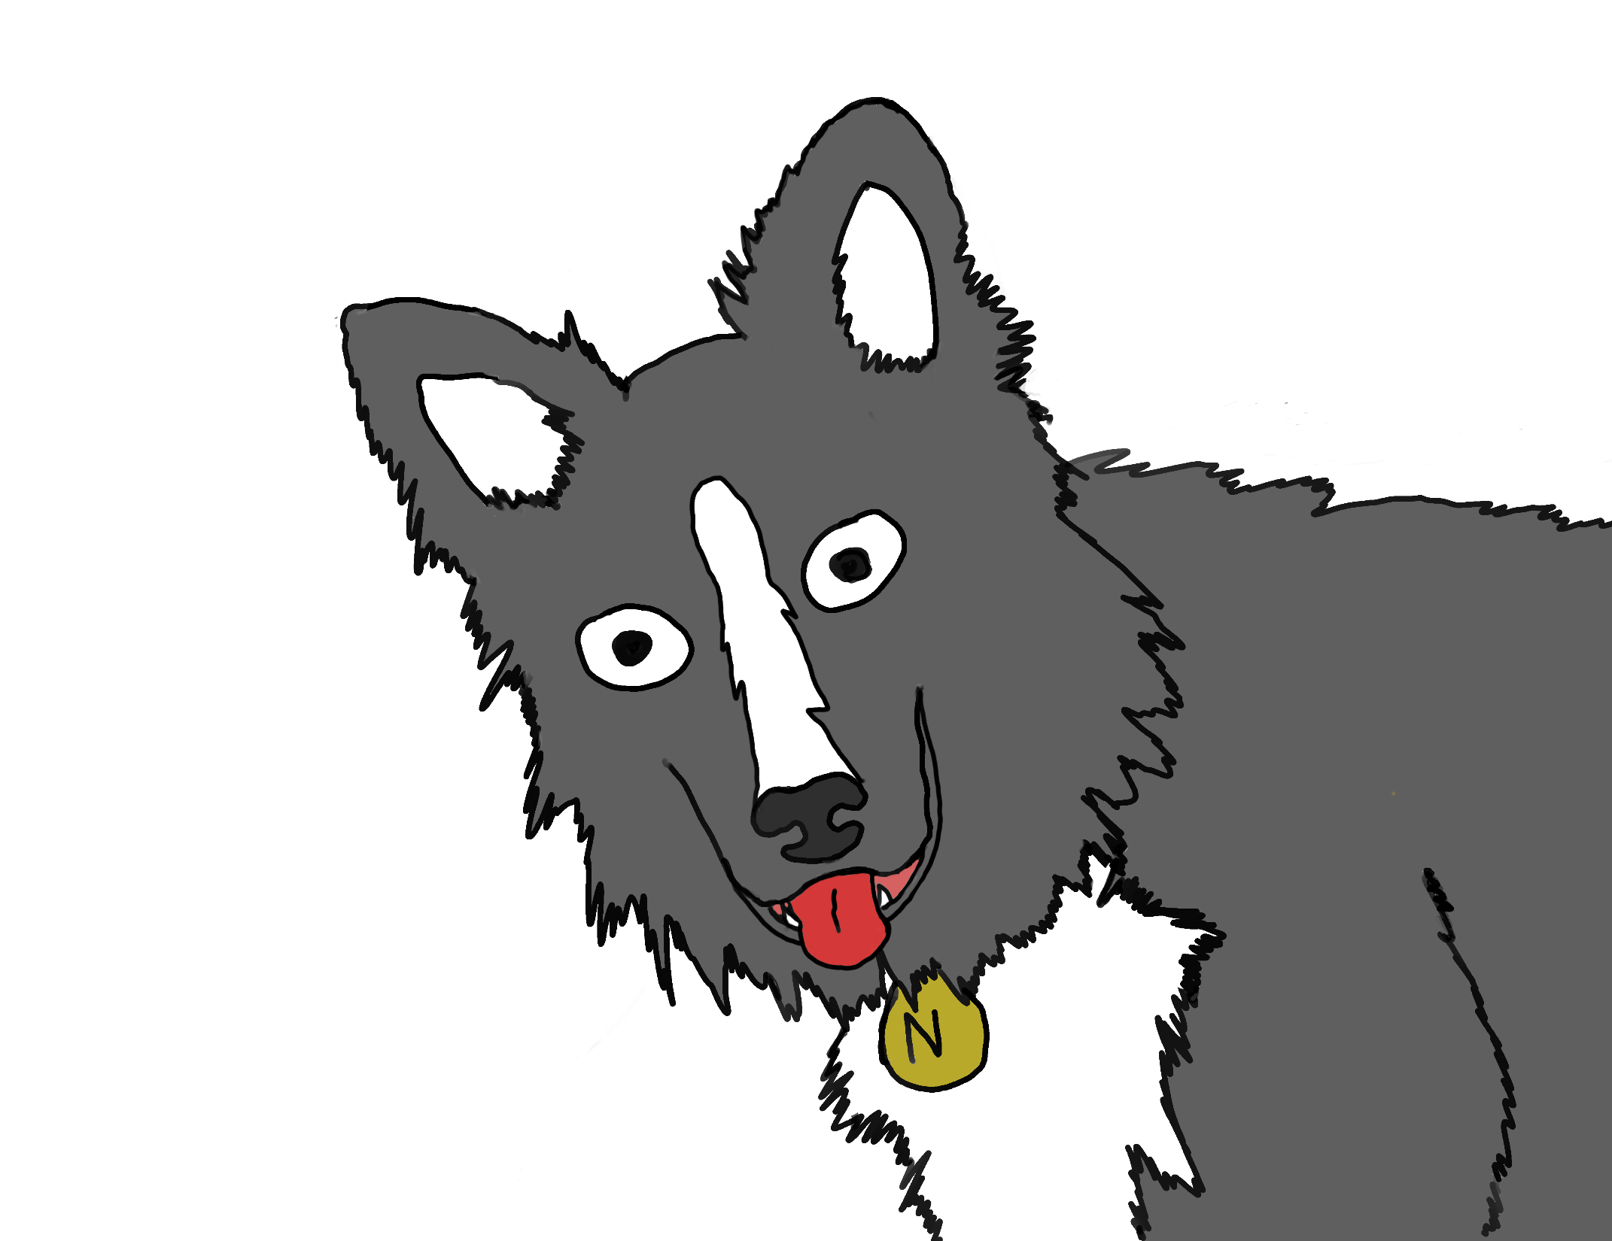

Slide 16
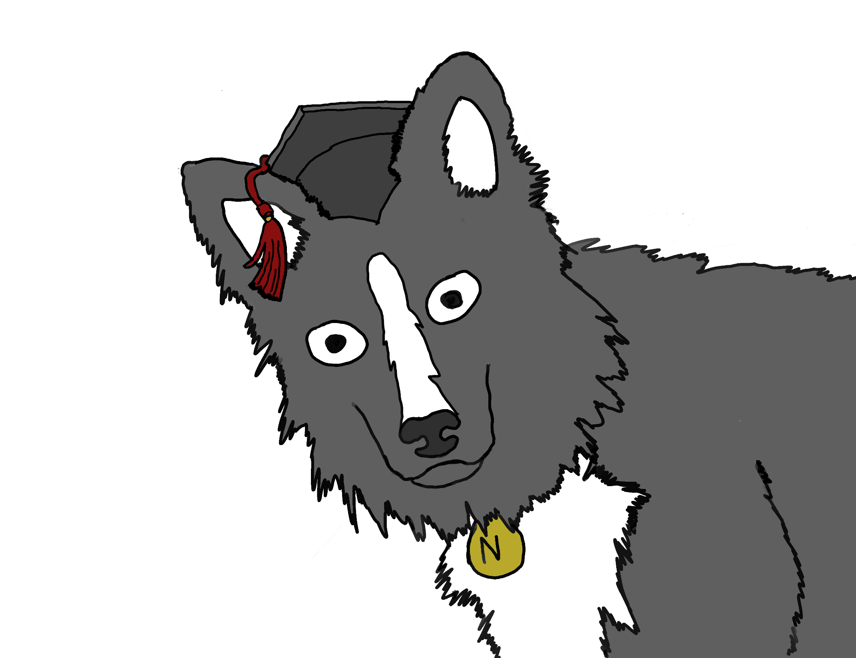

Slide 17
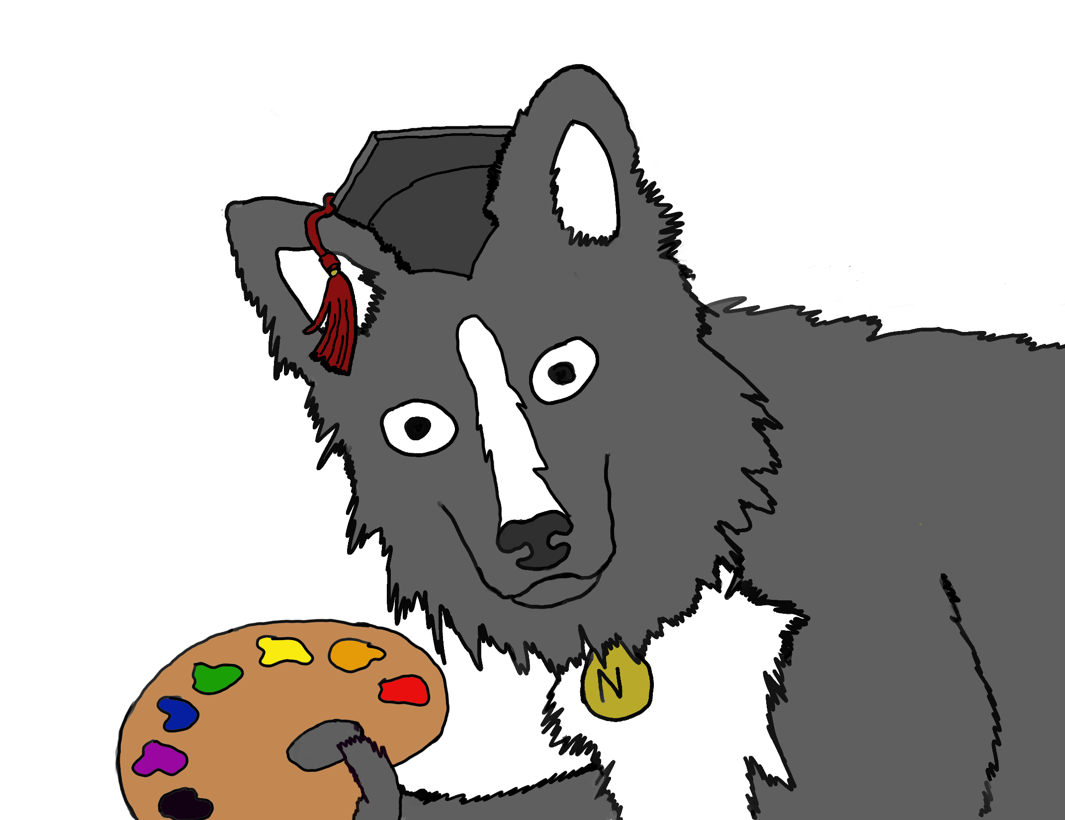

Slide 18
Why does Noodles exist?

Slide 19
System 2
Uses lots of glucose
System 1
Uses less glucose

Slide 20
System 2 is cognitively lazy

Slide 21
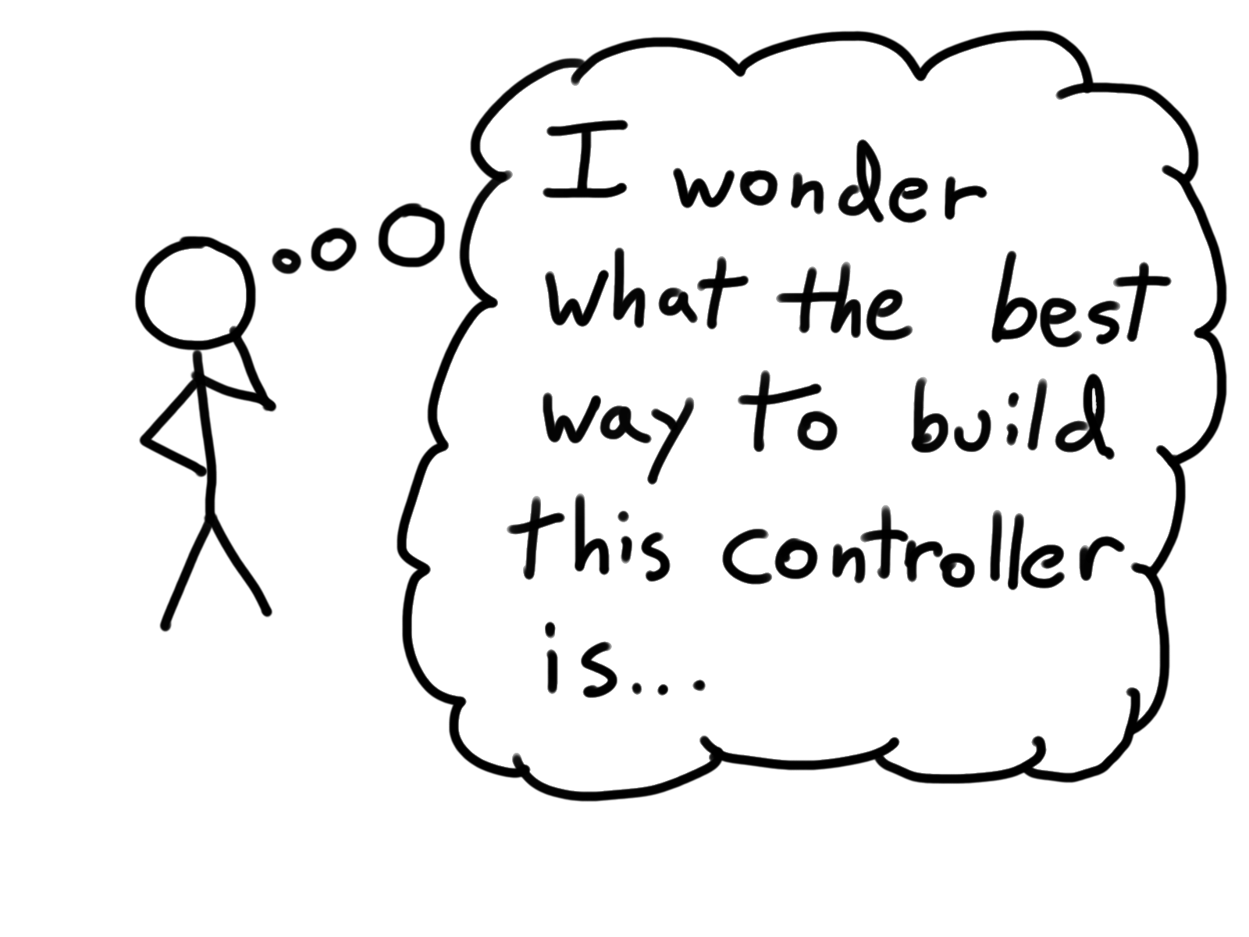

Slide 22
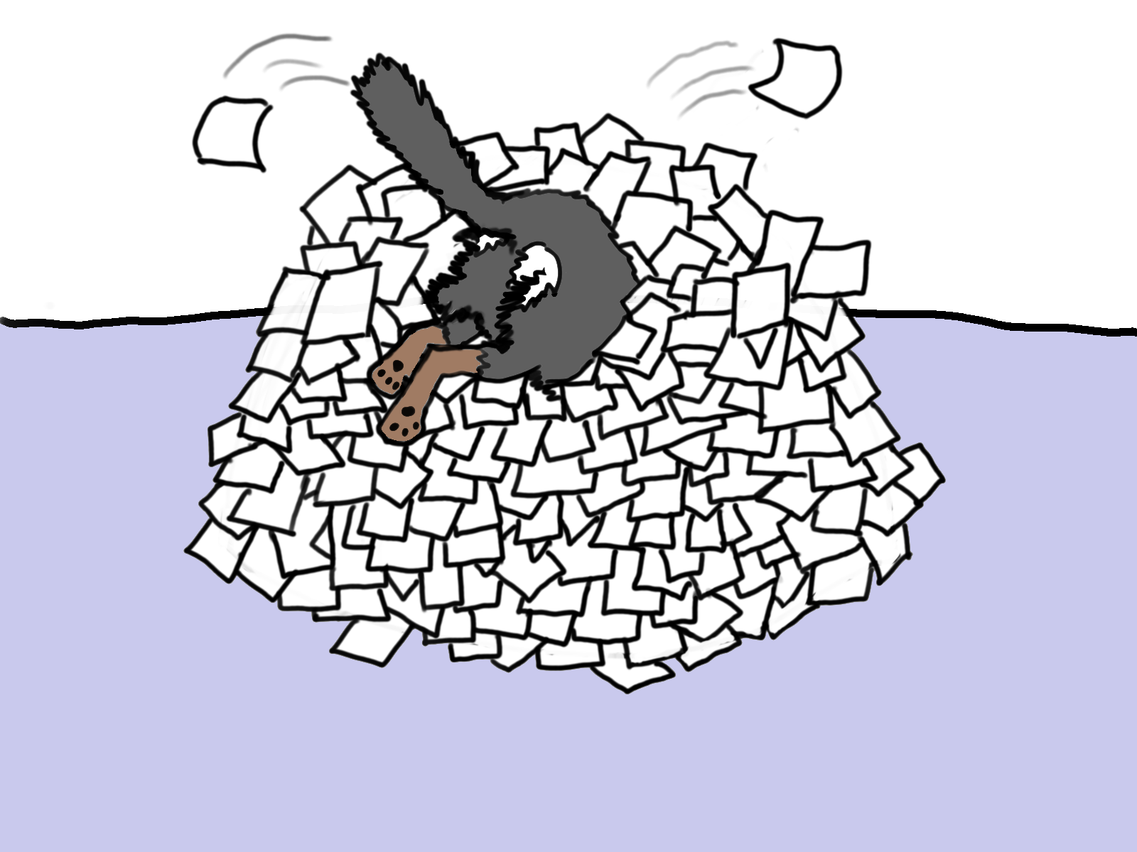

Slide 23
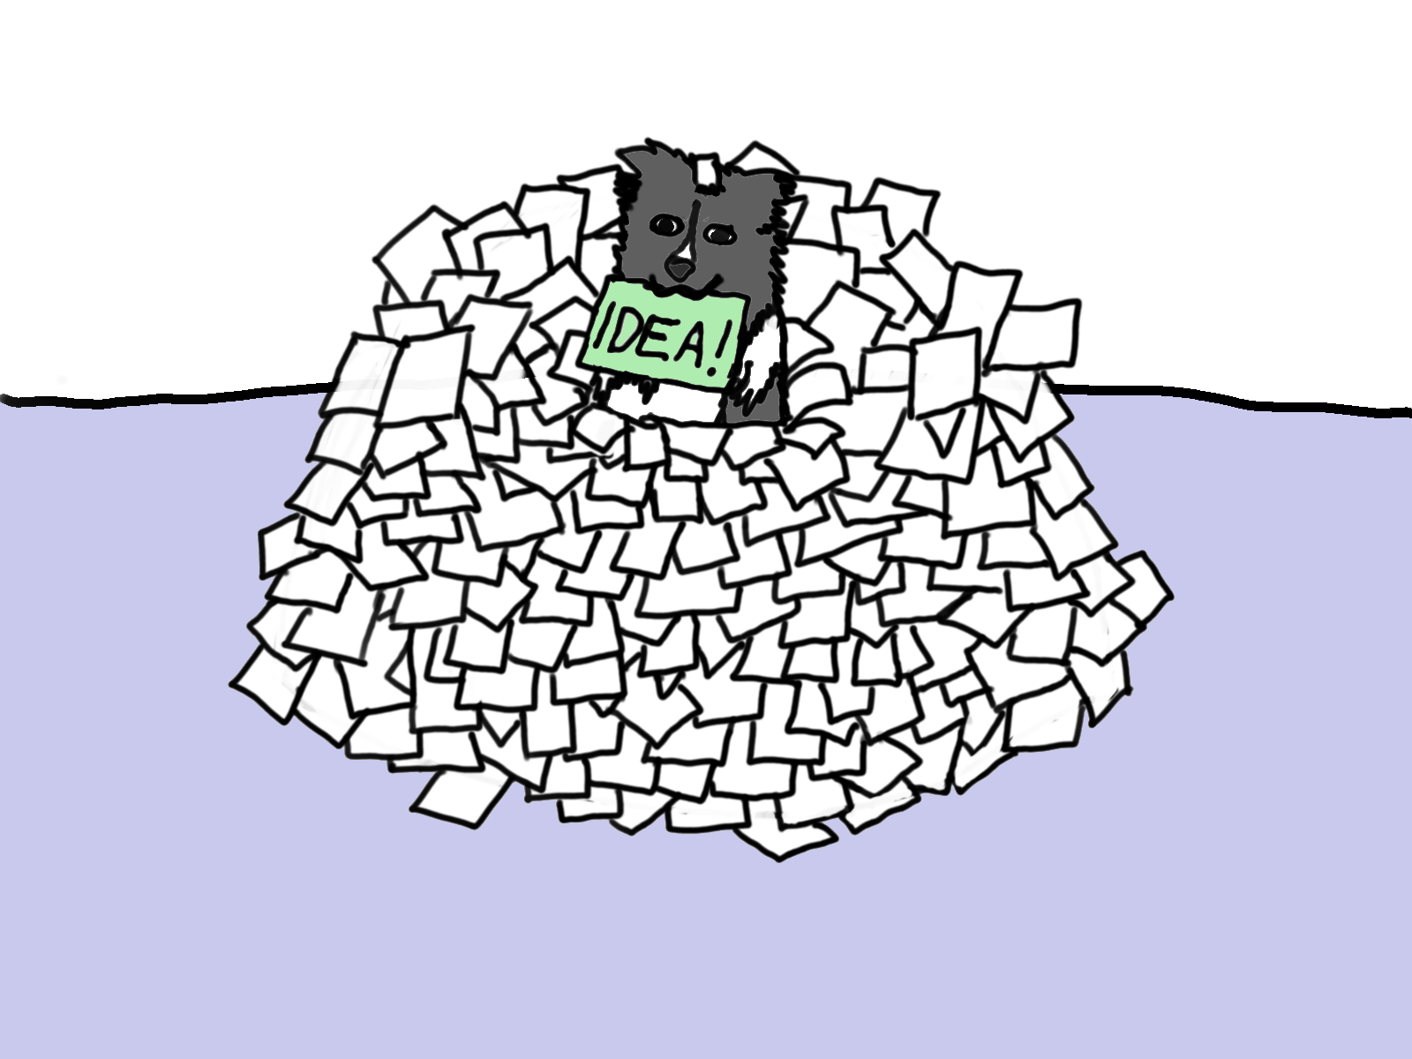

Slide 24

IDEA!

Slide 25
I rarely ever question what Noodles brings me
But Noodles’ whole job is to be lazy

Slide 26
YOU NEVER KNOW WHAT NOODLES IS THINKING!!!!
Notes:
The lack of communication leads to hiccups

Slide 27
A bat and a ball cost $1.10.
The bat costs one dollar more than the ball.
How much does the ball cost?

Slide 28
What can I do about this?

Slide 29
You can never really control noodles! The only real tool is awareness

Slide 30
Narrative Bias
Attribution Errors
Fundamental Attribution Error
Group Attribution Error
Ultimate Attribution Error
Choice-Supportive Bias
Framing and Anchoring Effects
Hindsight Bias
Illusion of Control
Change Bias
Egocentric Bias
Bias Blind Spot

Slide 31
Now let’s actually get to some retrospectives!

Slide 32
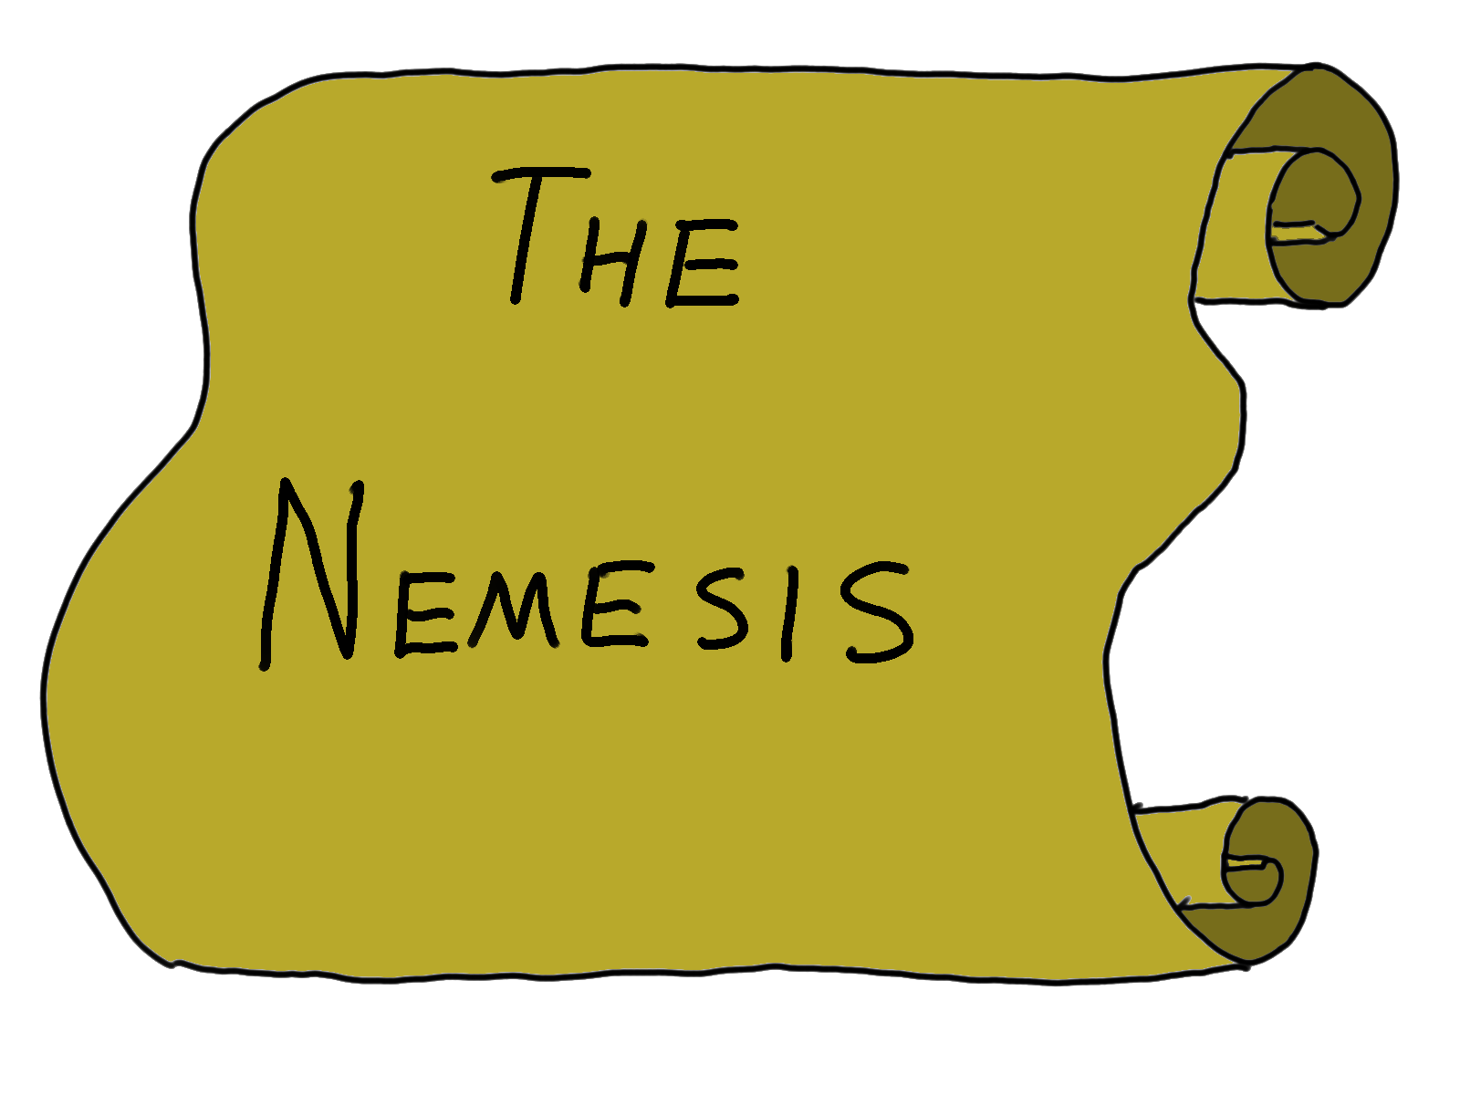

Slide 33
Narrative Bias

Slide 34
Narrative Bias
Fallacy

Slide 35
Narrative Bias
Fallacy
Heuristic

Slide 36
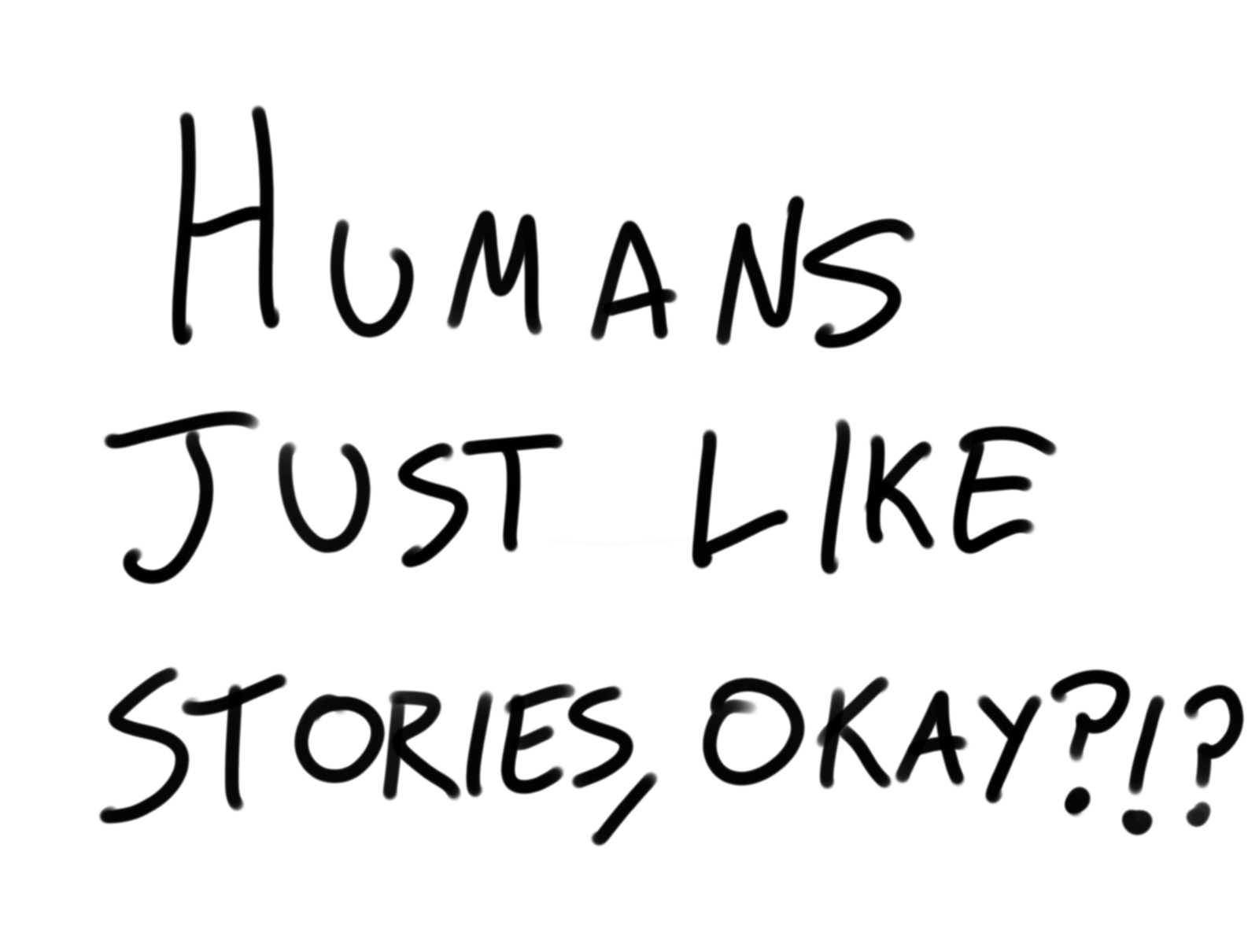

Slide 37
Humans do not process narrative data in the same way we process factual data

Slide 38
Fred’s parents arrived late.
The caterers were expected soon.
Fred was angry.

Slide 39
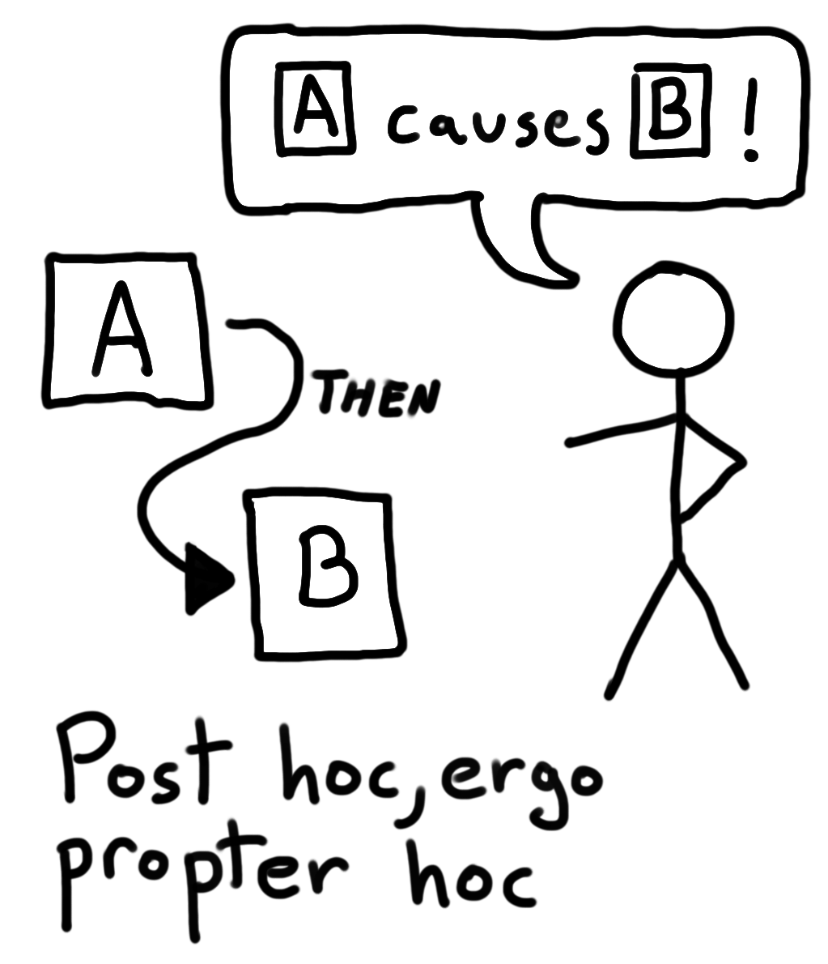

Slide 40
After spending a day exploring beautiful sights in the crowded streets of New York, Jane discovered that her wallet was missing.

Slide 41
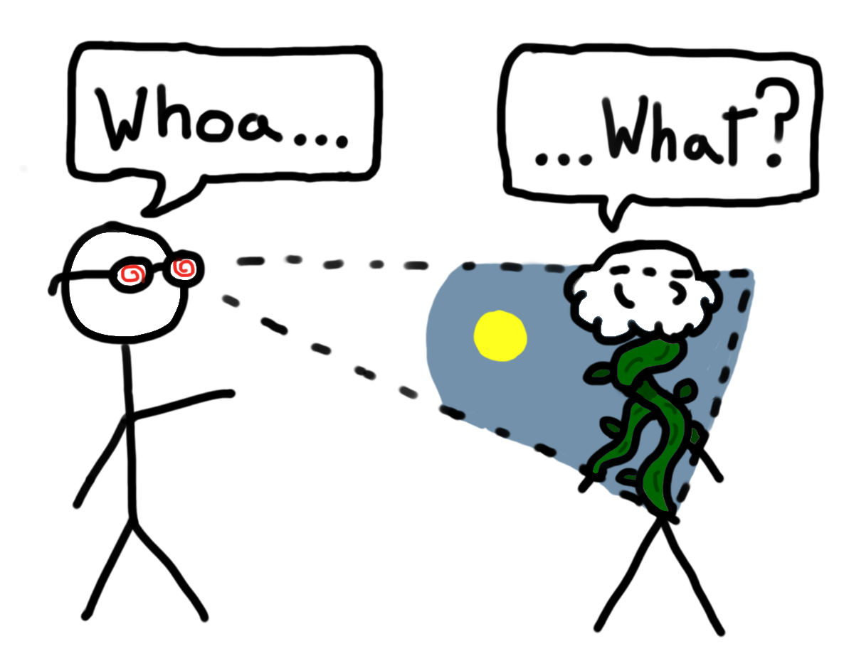
Notes:
We see story everywhere

Slide 42
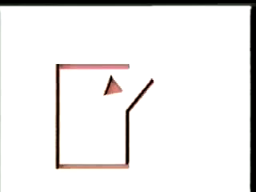

Slide 43
Humans see conflict as narratives

Slide 44
What is Noodles doing?

Slide 45
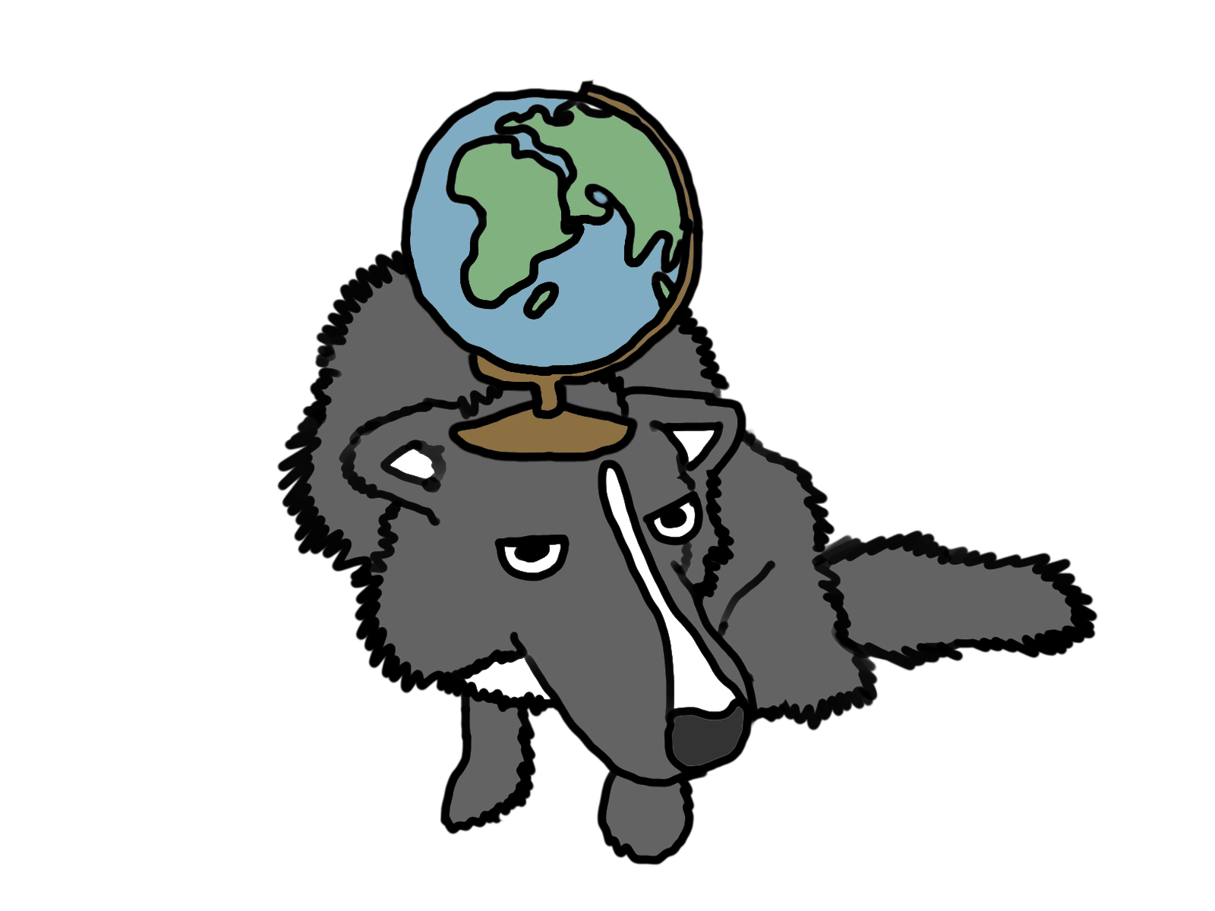

Slide 46
What can you do?

Slide 47
You are a story that you are telling yourself.

Slide 48
Recognize that causality is complex
When you ask “Why did X happen?”, avoid stopping at answers that center on a person
Realize that the more distant an effect is from a cause, the less likely it is that Noodles will identify that cause

Slide 49
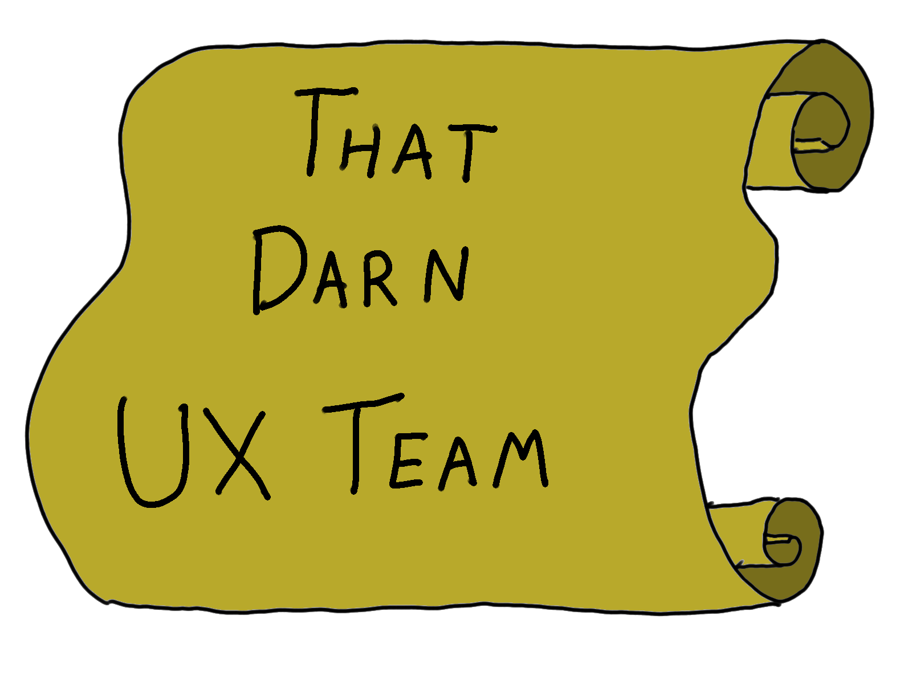

Slide 50
Attribution Errors

Slide 51
Fundamental Attribution Error

Slide 52
“The intuitive psychologist and his shortcomings: Distortions in the attribution process”

Slide 53
Jones and Harris, 1967

Slide 54
Test Procedure:
Subjects read both pro- and anti-Castro articles
Rated the authors on their sentiments about Castro
Control Group:
Not told anything
Test Group:
Told the author chose their side based on a coin flip

Slide 55
Attributed the opinion of the piece to the author
Control Group:
Test Group:
Did the same thing!

Slide 56
MY actions are due to my surrounding circumstances YOUR actions are due to your inherent attributes

Slide 57
What is Noodles doing?

Slide 58
Noodles thinks he’s good at figuring out why people act the way they do… he’s wrong we only see them and their actions, not their circumstances

Slide 59
Group Attribution Error
Type 1 and Type 2

Slide 60
Type 1 ANY member of a group I am not part of is representative of that group

Slide 61
Type 2 ALL members of a group agree with decisions that group makes

Slide 62
What is Noodles doing?

Slide 63
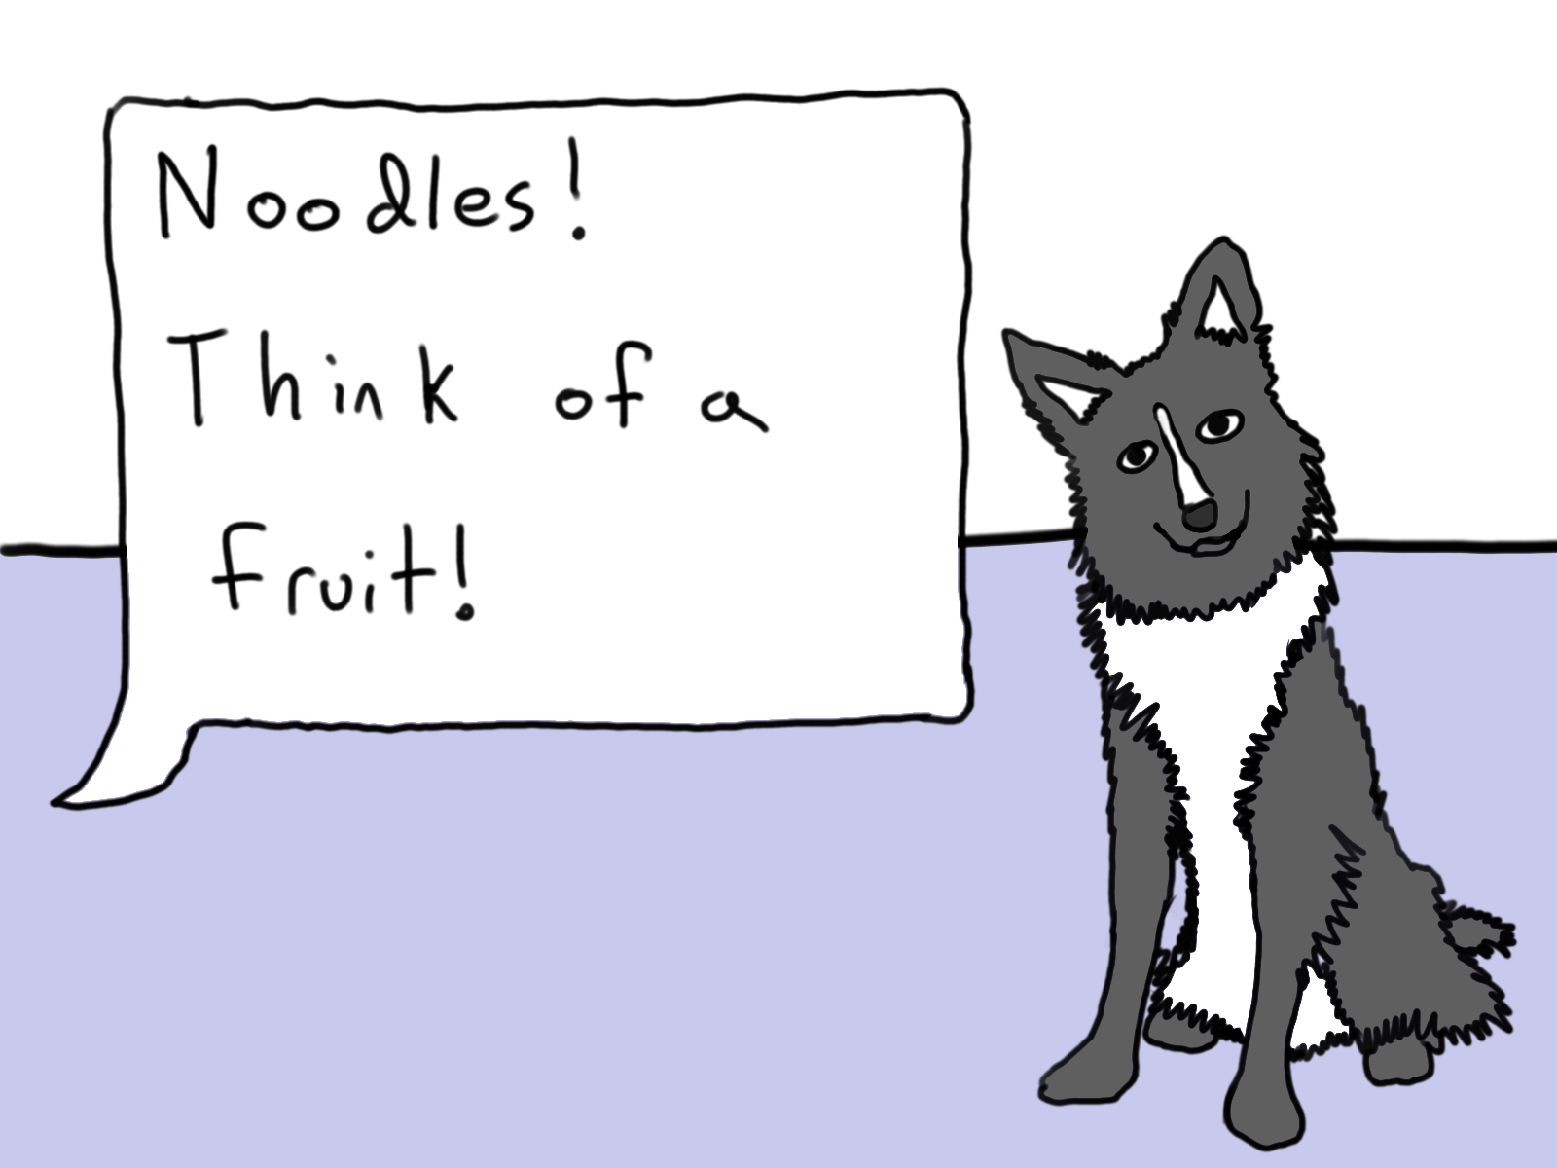

Slide 64
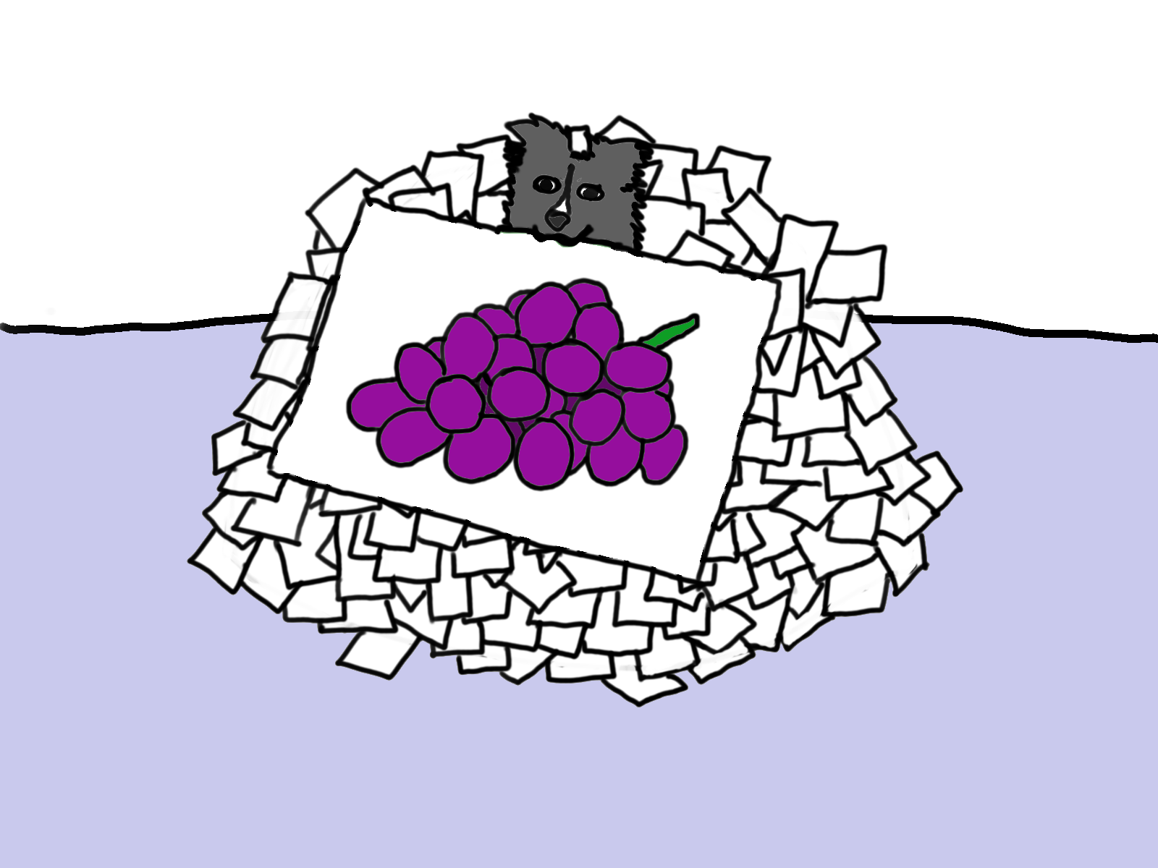

Slide 65
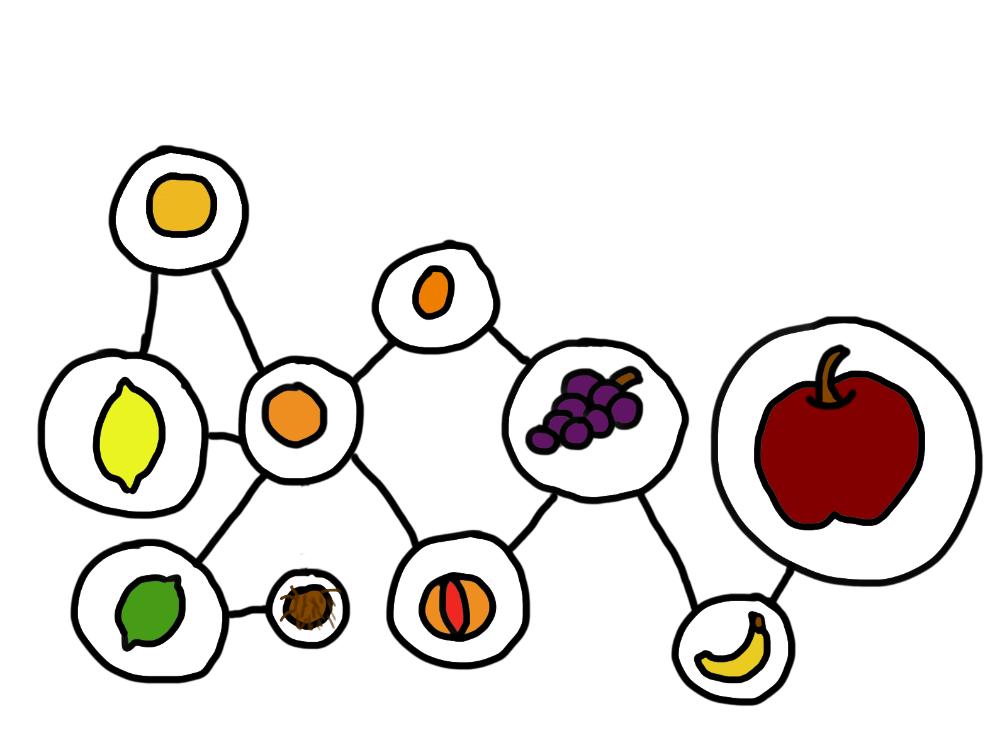

Slide 66
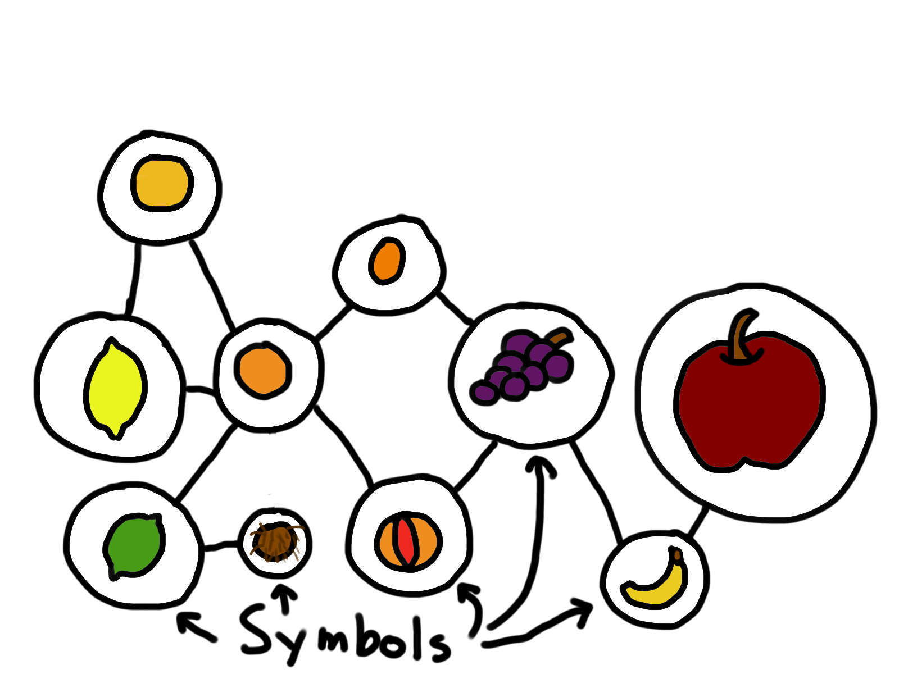

Slide 67


Slide 68
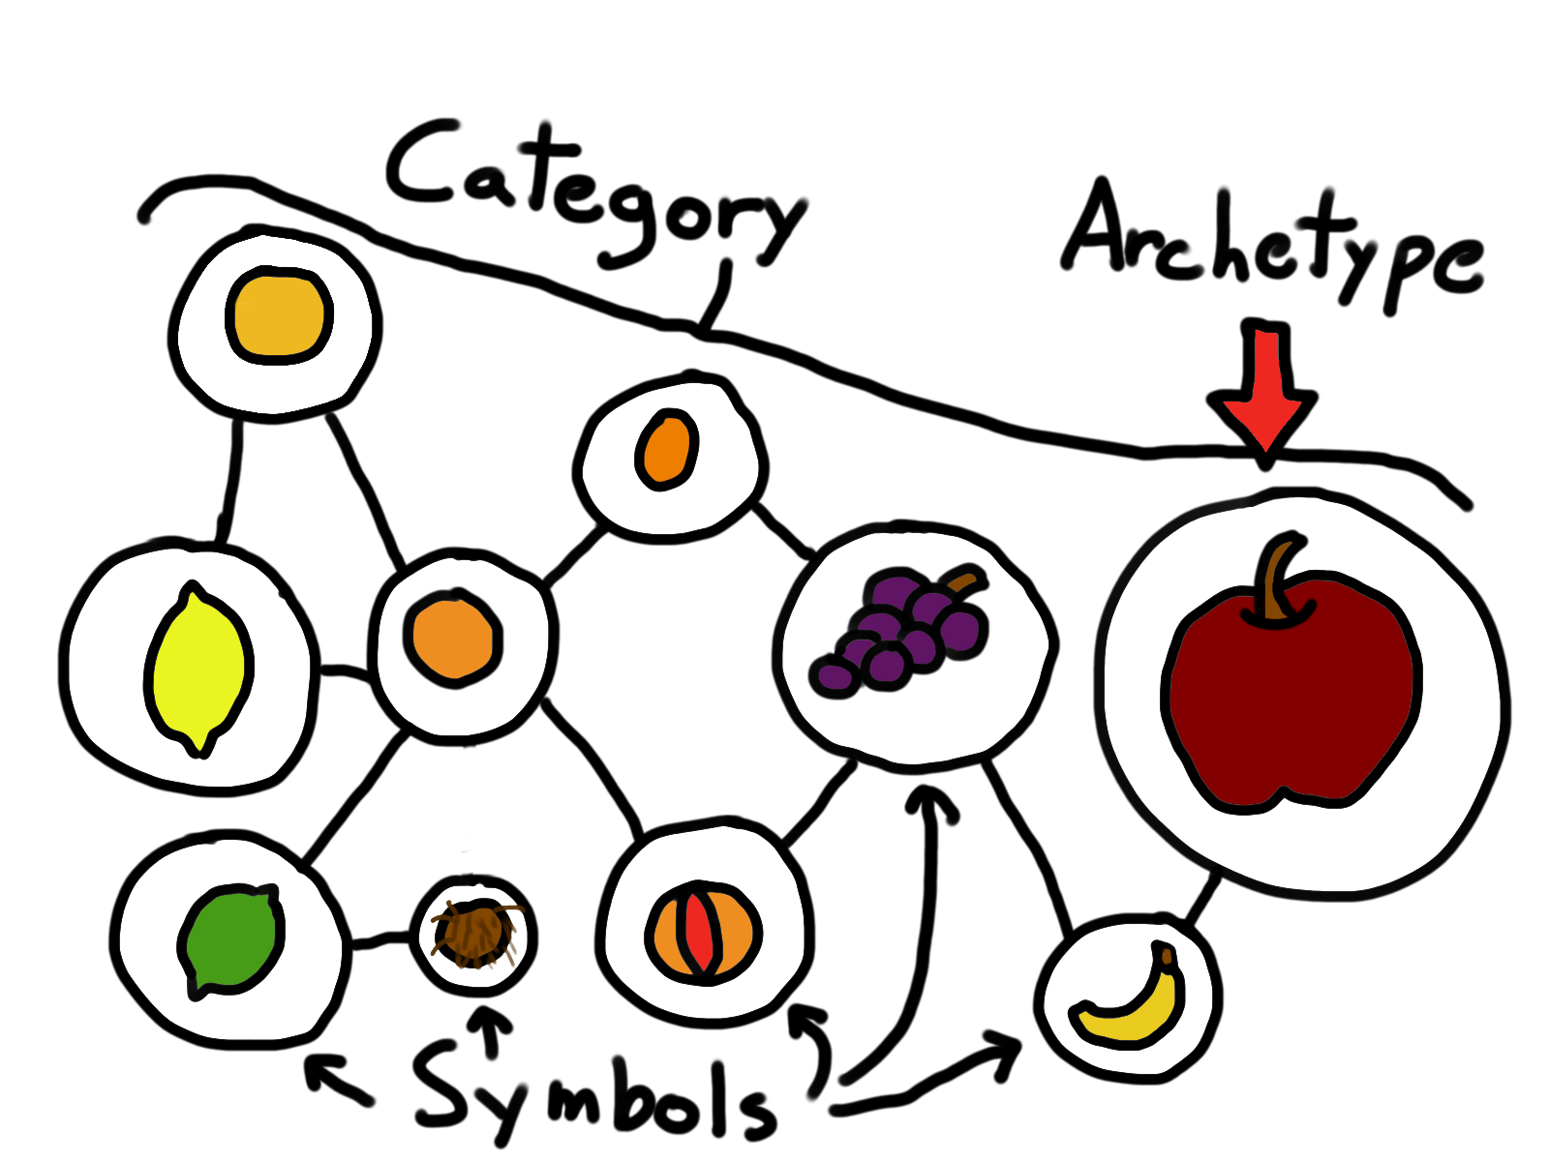
Notes:
Or “Exemplar”

Slide 69
Ultimate Attribution Error

Slide 70
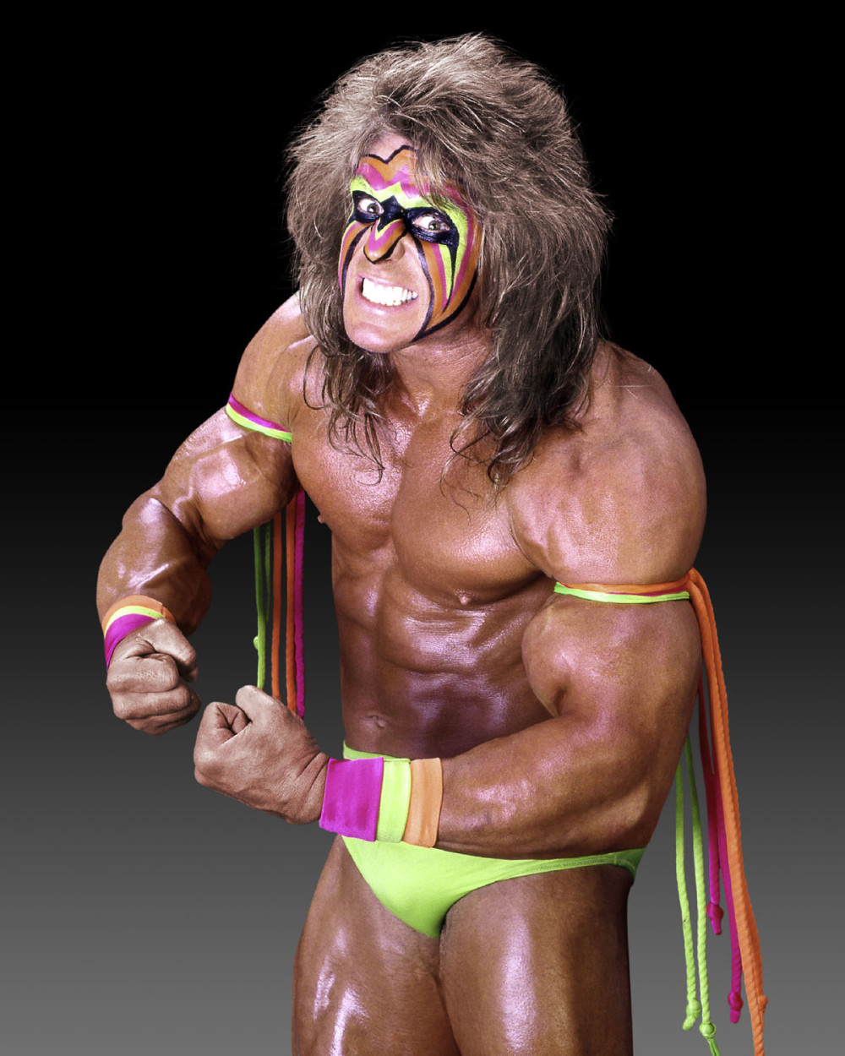

Slide 71
MY ingroup’s actions are due to our surrounding circumstances YOUR ingroup’s actions are due to your inherent attributes

Slide 72
YOUR ingroup’s negative actions are due to your inherent attributes YOUR ingroup’s positive actions can be explained away

Slide 73
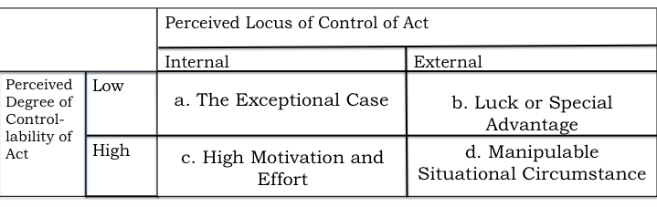

Slide 74
What can you do?

Slide 75
Most types of attribution error deal with outgroups
We deal with outgroups daily:
Customers
QA
UX
Managers
Etc…

Slide 76
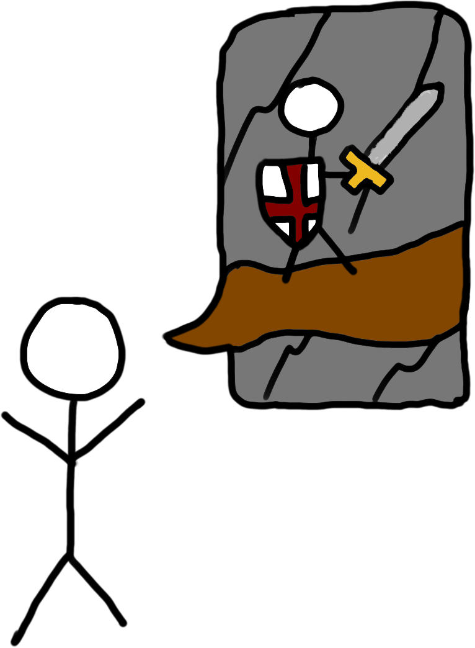

Slide 77
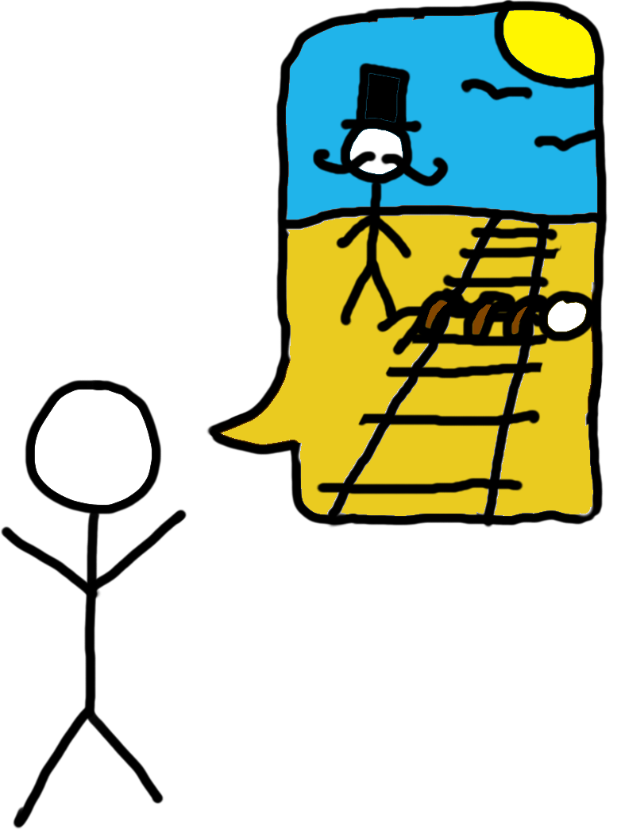

Slide 78
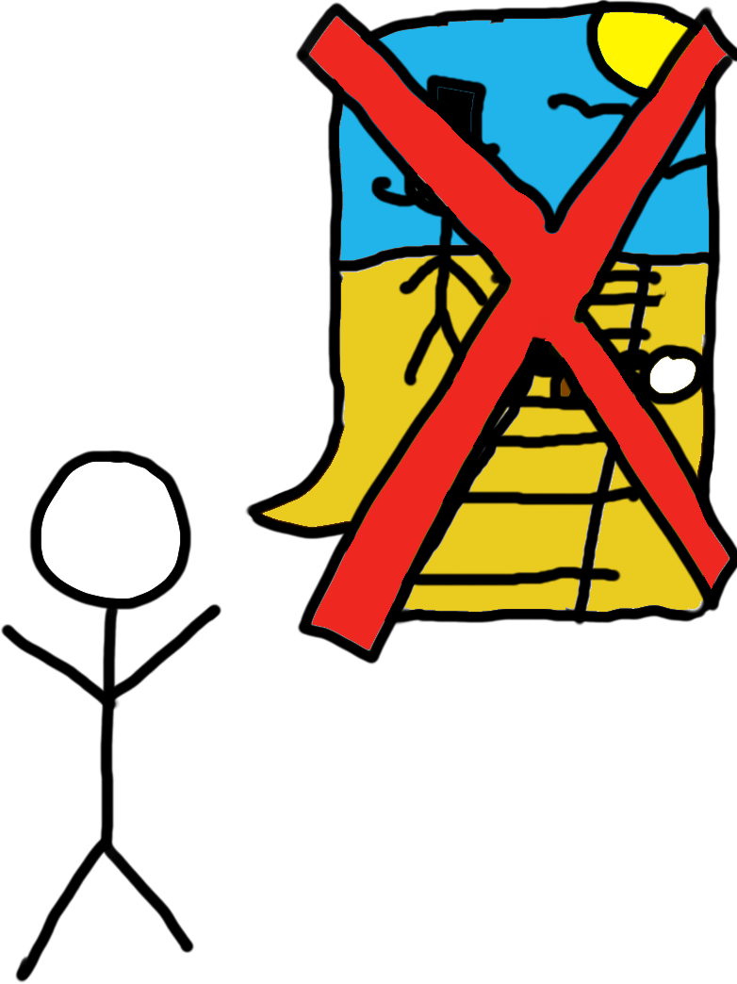

Slide 79
Try to imagine other people’s story.
What do they value?
What do they see as their extenuating circumstances?
Actually go talk to people in your outgroups!
Find common goals and recast them as your ally

Slide 80
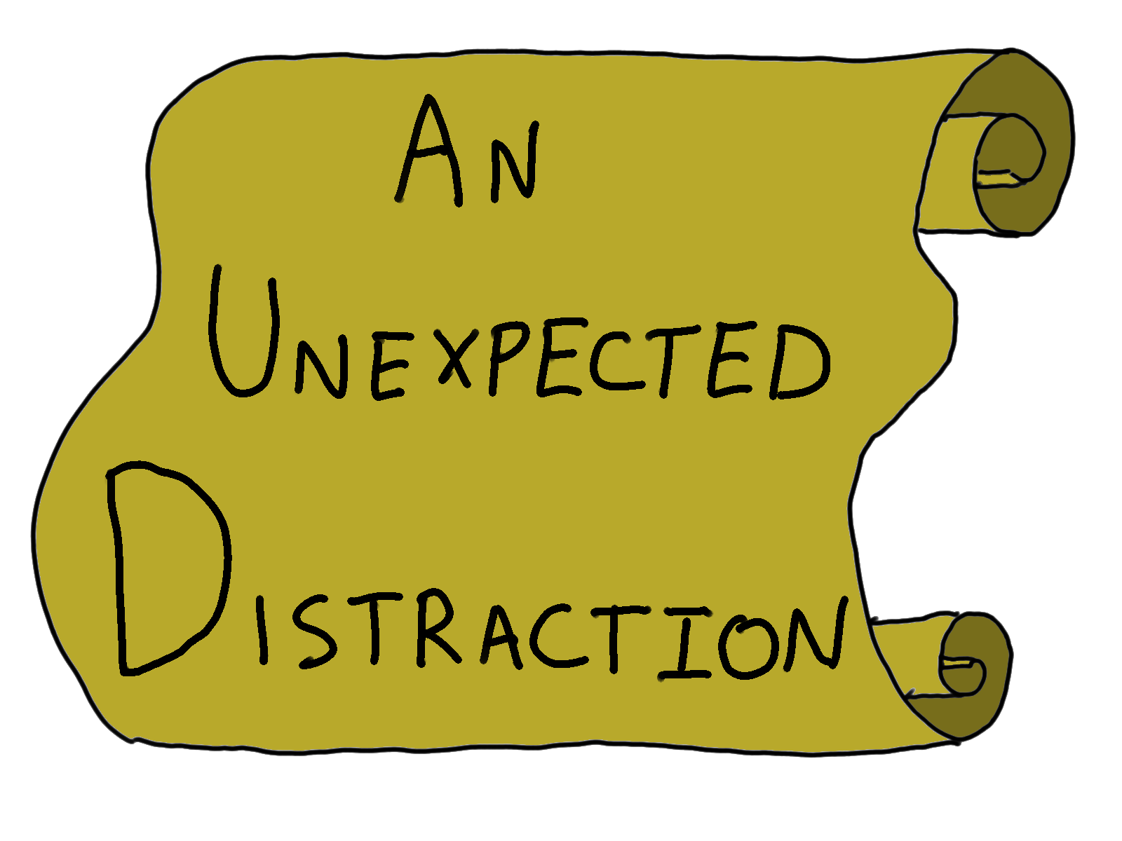
Notes:
Make this example about positive

Slide 81
Framing and Anchoring Effects

Slide 82
Framing

Slide 83
How an idea is introduced affects how you think about it (and the ideas after that)

Slide 84
Kahneman and Tversky, 1981

Slide 85
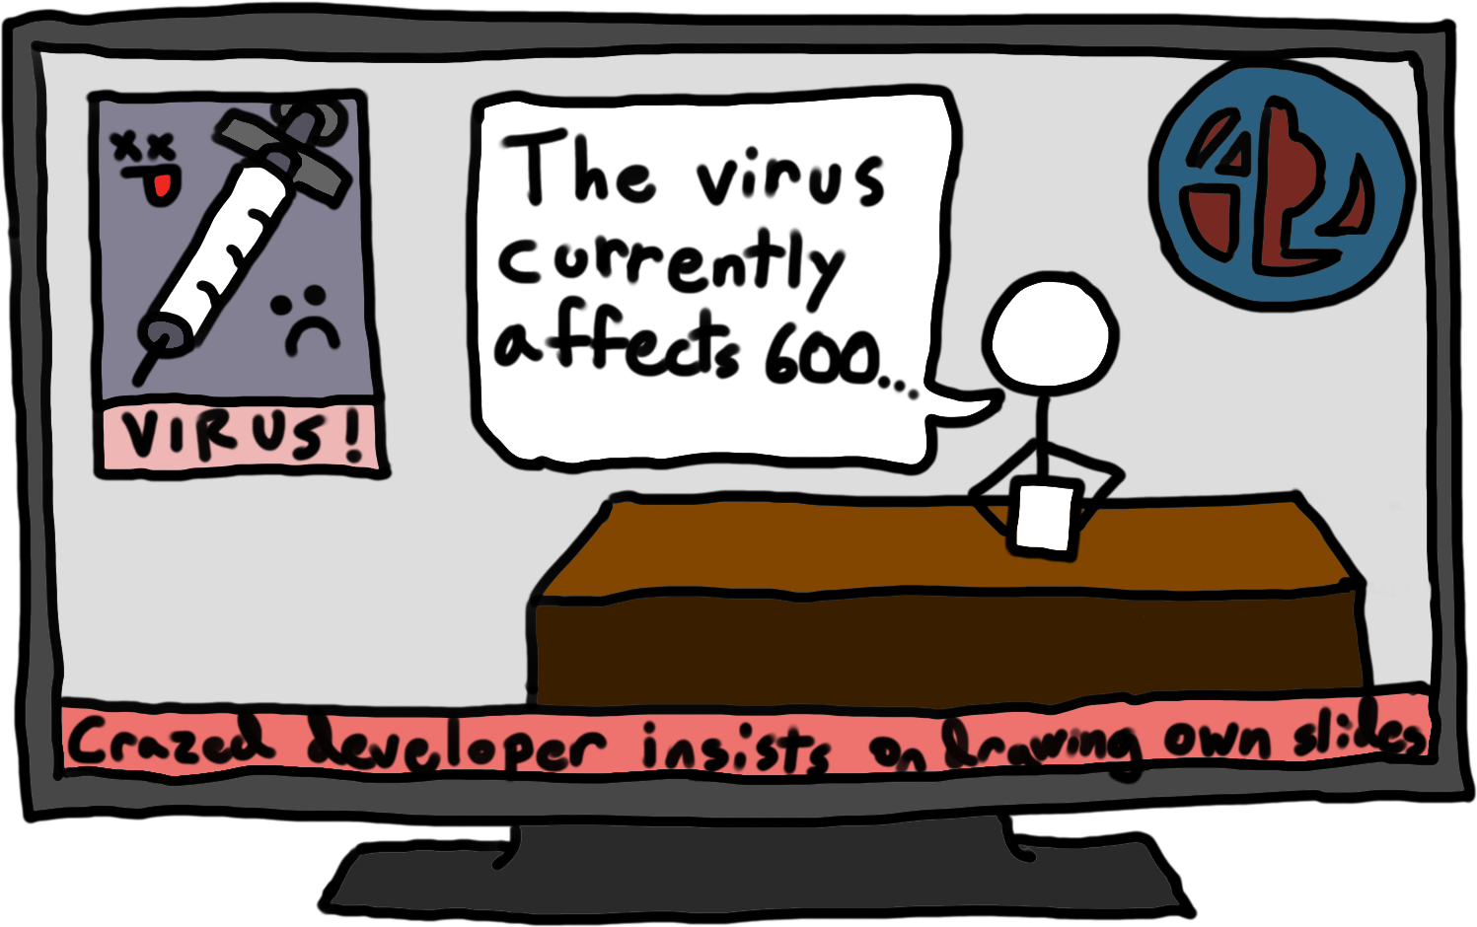

Slide 86
Treatment A:
200 people will live
400 people will die
Treatment B:
33% chance everyone will live
66% chance everyone will die

Slide 87
Treatment A
Saves 200 lives
Treatment B
A 33% chance of saving all 600 people, 66% possibility of saving no one
Positive Framing
Treatment A
400 people will die
Treatment B
A 33% chance that no people will die, 66% possibility that all 600 will die
Negative Framing

Slide 88
72% of people chose Treatment A when presented
with positive framing
78% of people chose Treatment B when presented
with negative framing

Slide 89
What is Noodles doing?

Slide 90
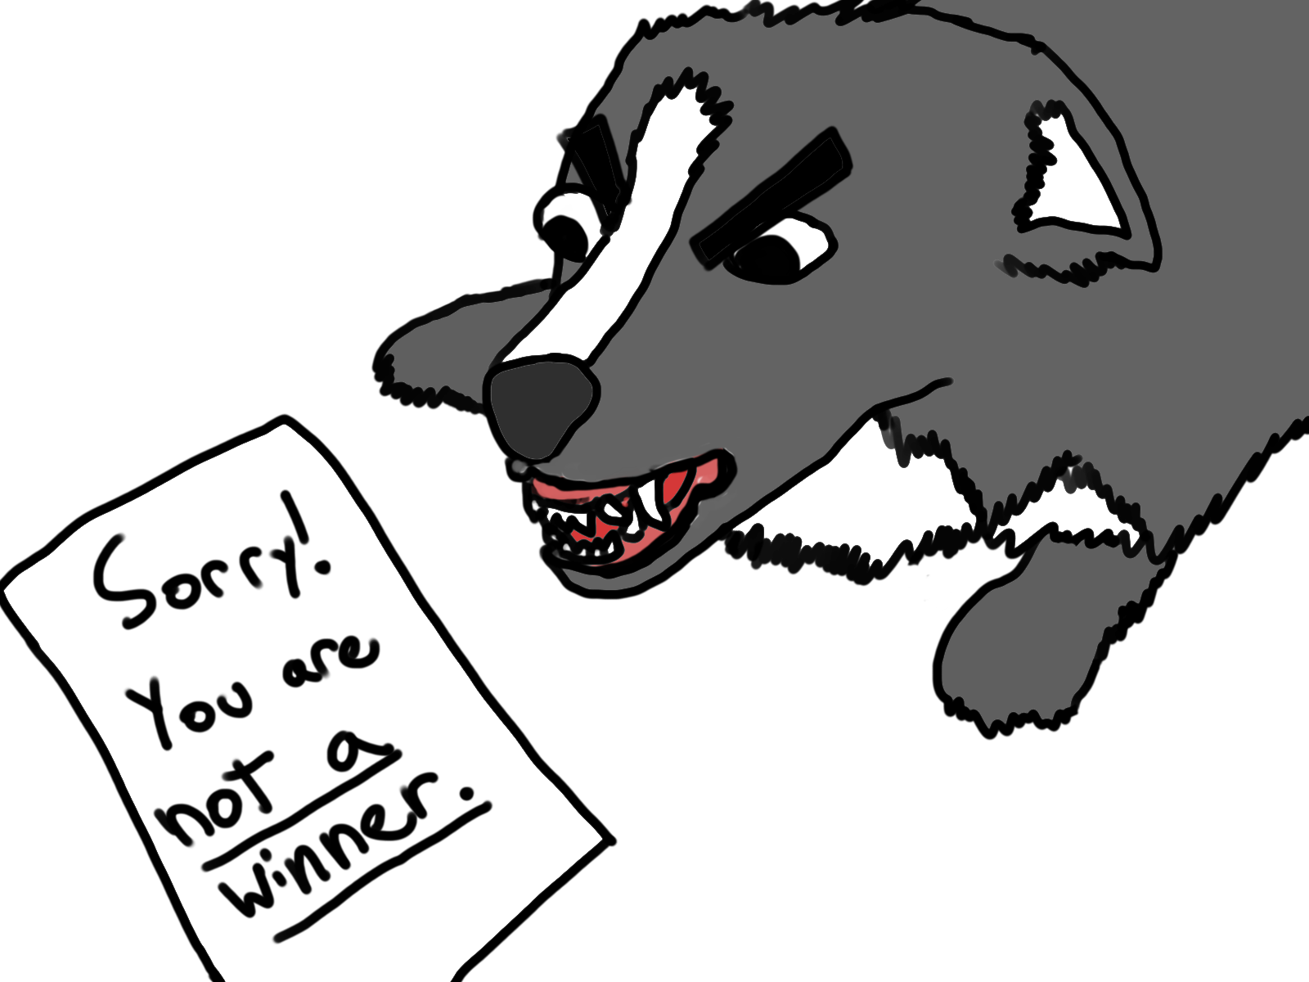
Notes:
Noodles hates losing!

Slide 91
Anchoring

Slide 92
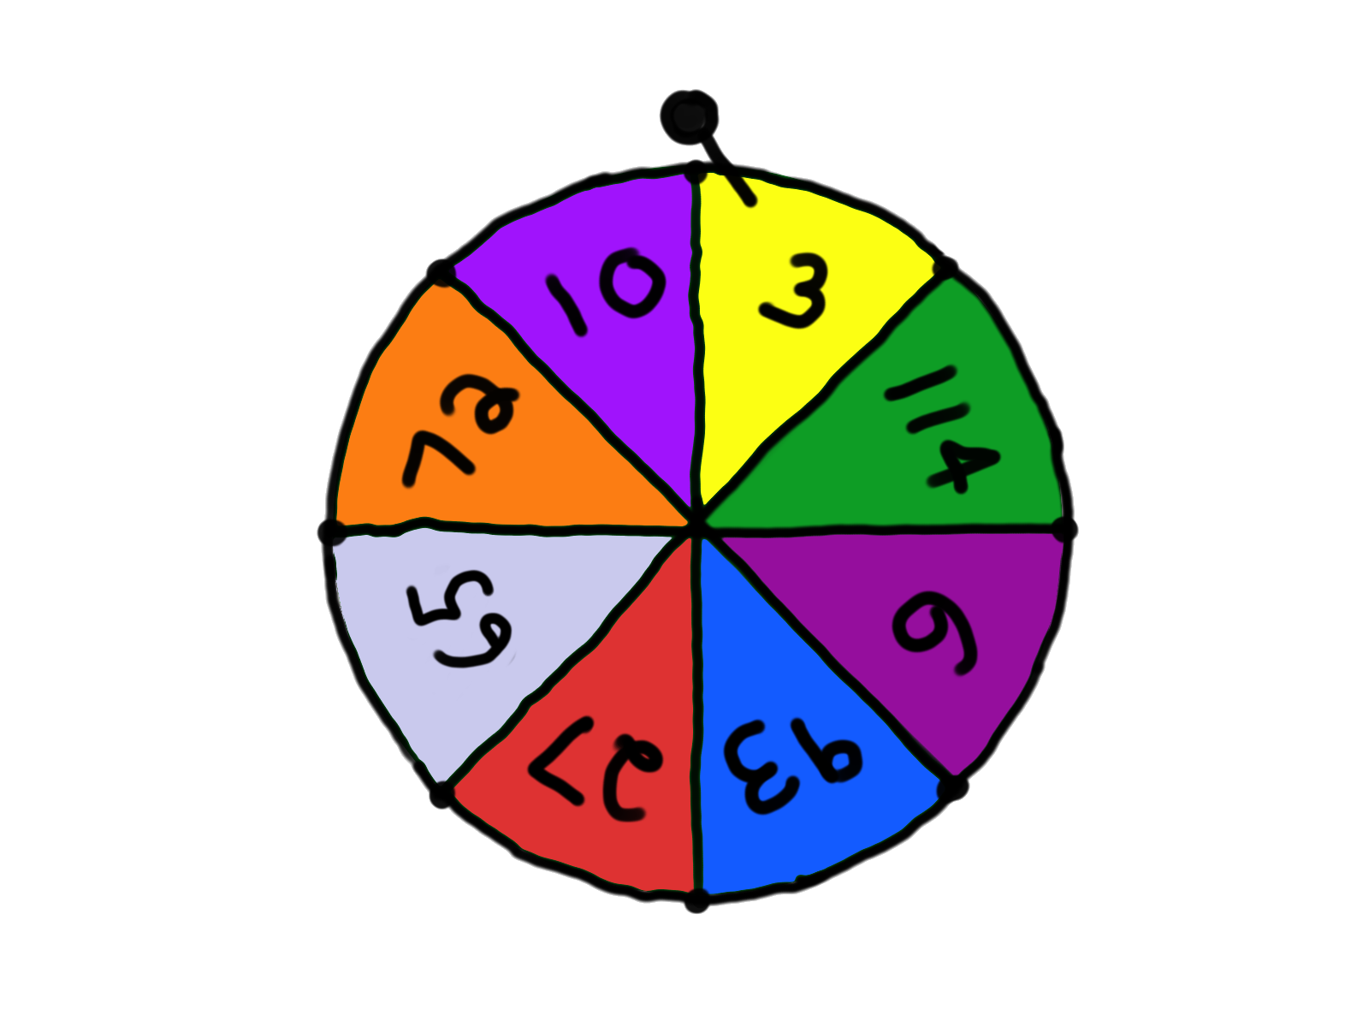

Slide 93
“What is your best guess of the percentage of African nations in the UN?”

Slide 94
Average estimate of people who spun 10:
24%
Average estimate of people who spun 65:
45%

Slide 95
What is Noodles doing?

Slide 96
Anchoring affects both you AND Noodles

Slide 97
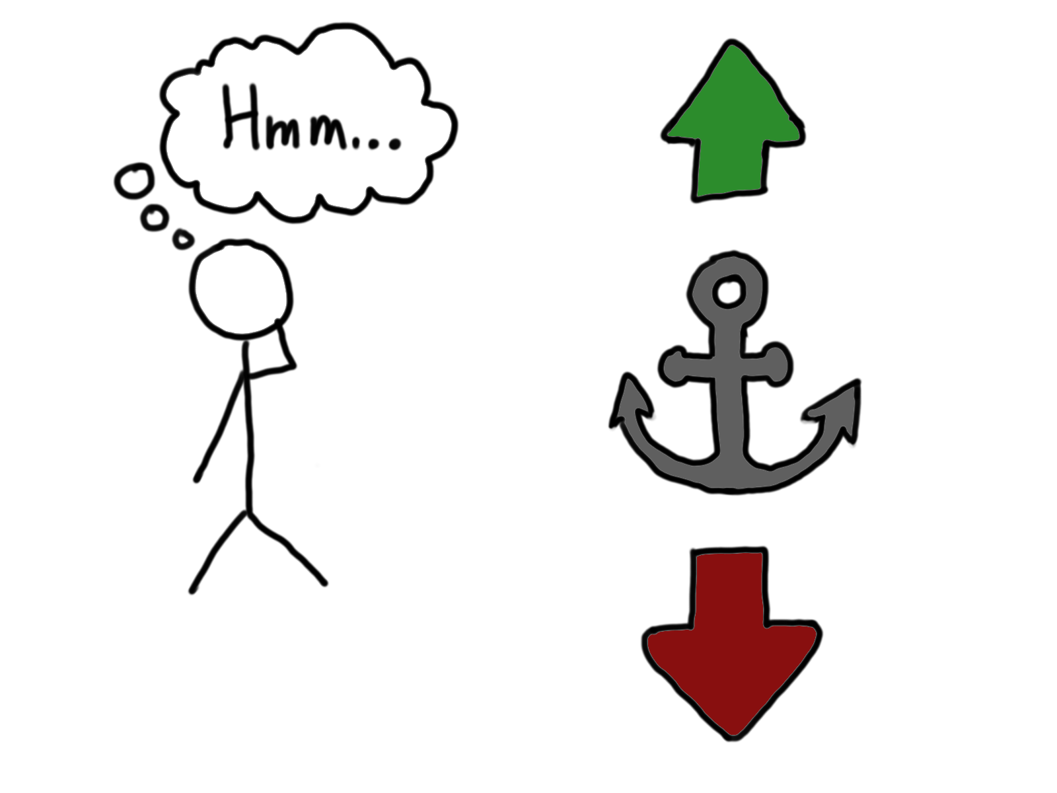

Slide 98
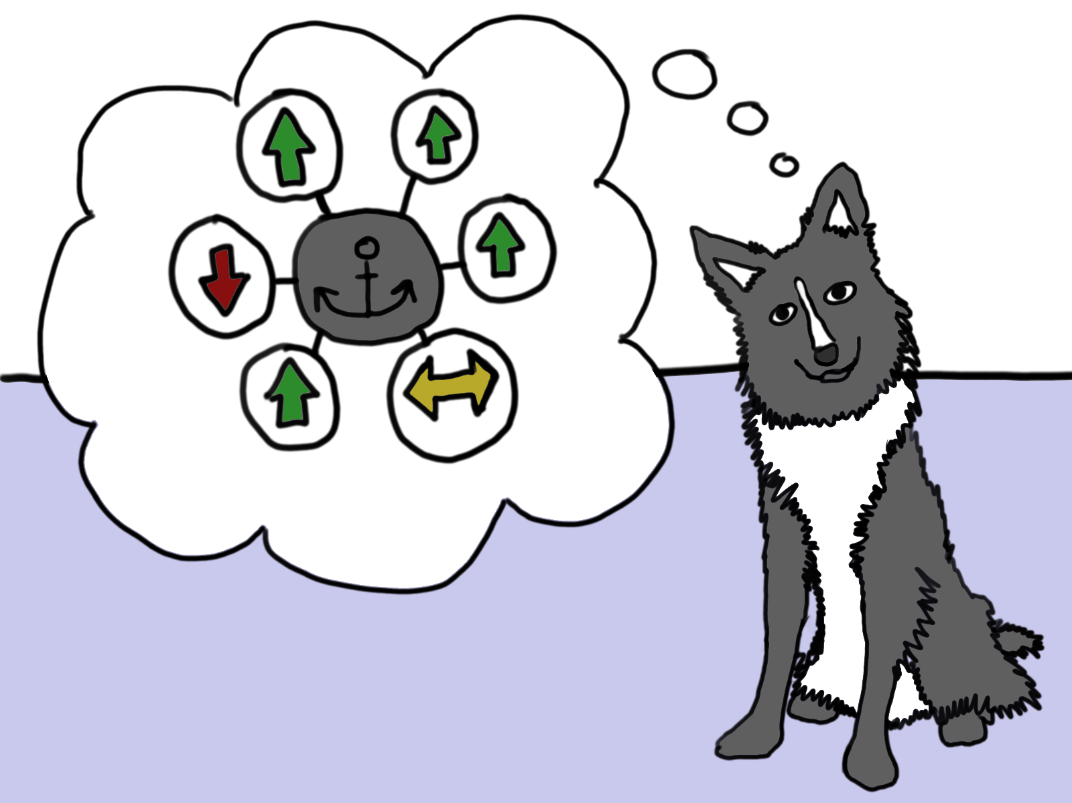

Slide 99
What can you do?

Slide 100
Avoid anchoring by:
Recording opinions before discussion
Voting on topics to discuss instead of allowing the first topic to come up to dominate
Use secret ballots if necessary
(The Lean Coffee techniques are a really huge help here)

Slide 101
Avoid framing by:
Using neutral frames
Using frames that are large enough to encompass the whole picture
If all else fails, use multiple frames at once

Slide 102
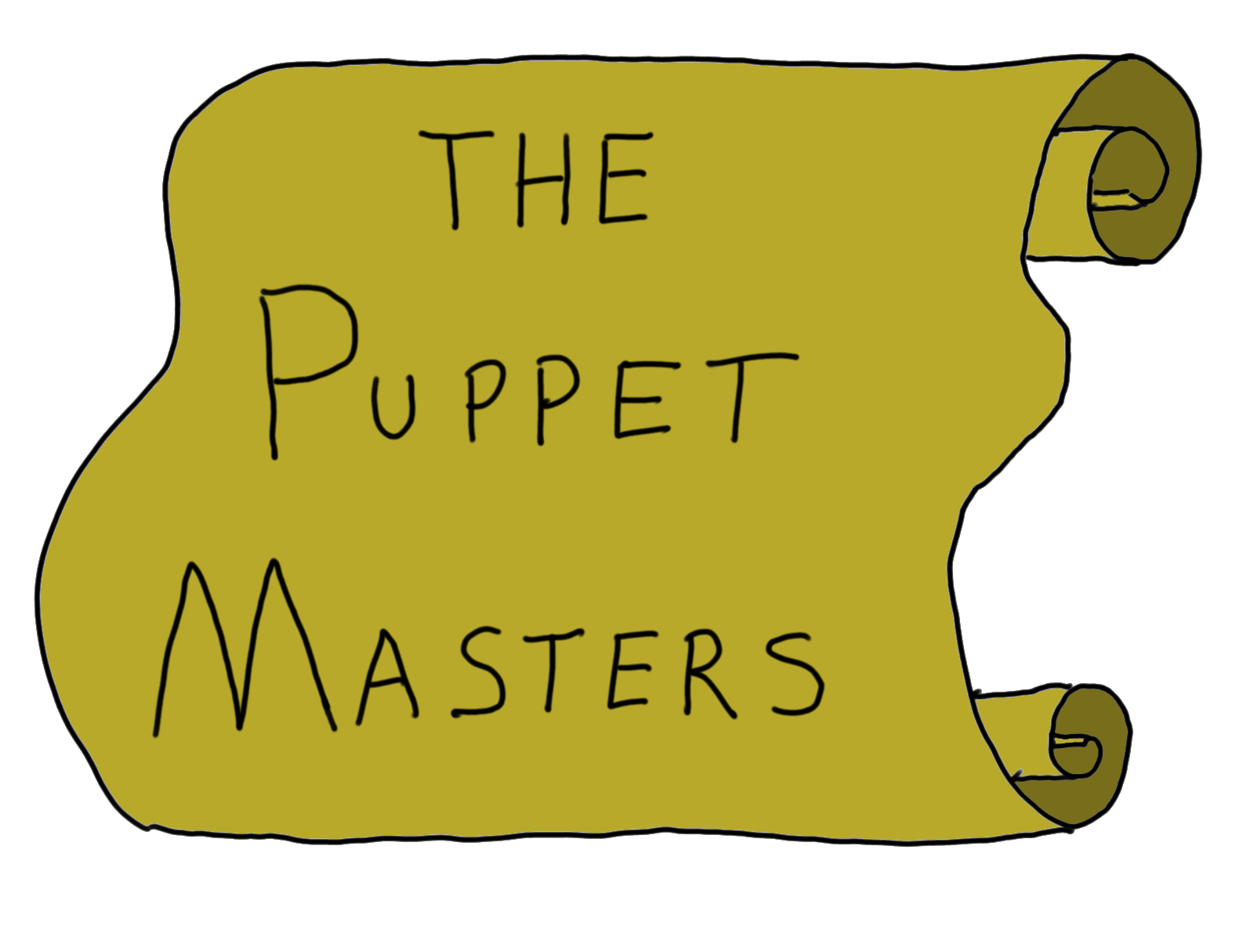

Slide 103
Illusion of Control

Slide 104
Jenkins and Ward, 1965

Slide 105
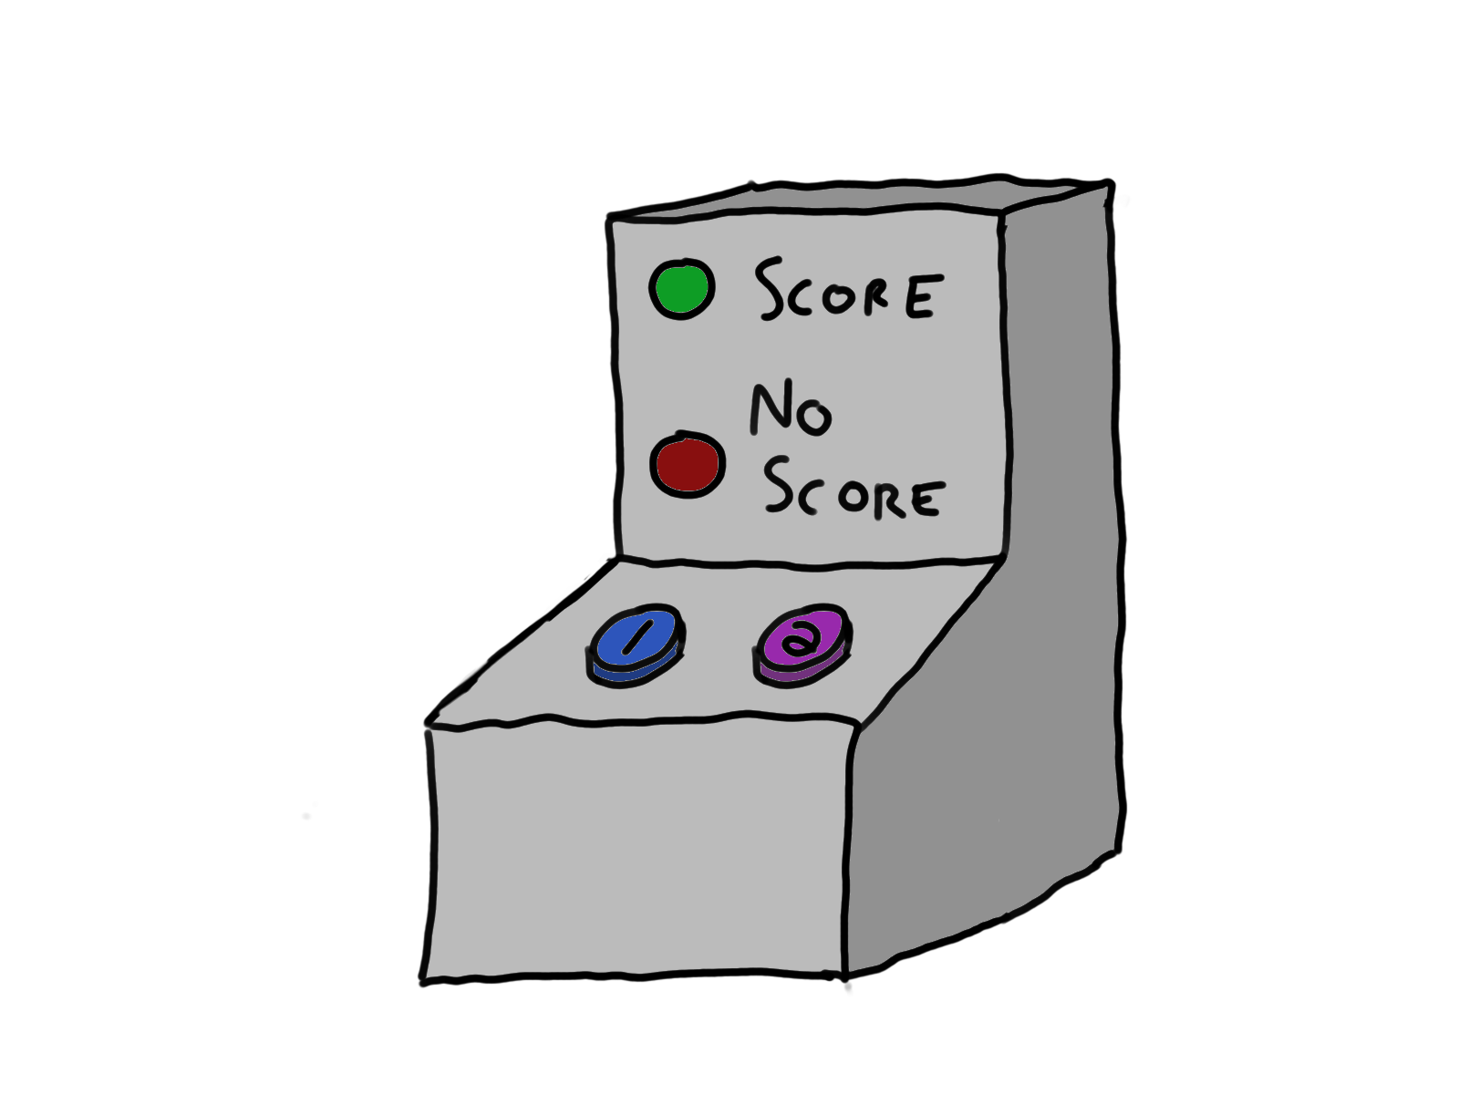

Slide 106
Estimates of control bore no relation to actual control … but were correlated to how often “Score” lit up

Slide 107
Control heuristic
You need:
An intention to create the outcome
A relationship between an action and the outcome

Slide 108
What is Noodles doing?

Slide 109
Noodles wants to make you more effective Plus, Noodles hates not feeling in control

Slide 110
What can you do?

Slide 111
Remember that you can only control your own actions…
… but maybe not even the primary effects of those actions!
… and you can forget secondary effects

Slide 112
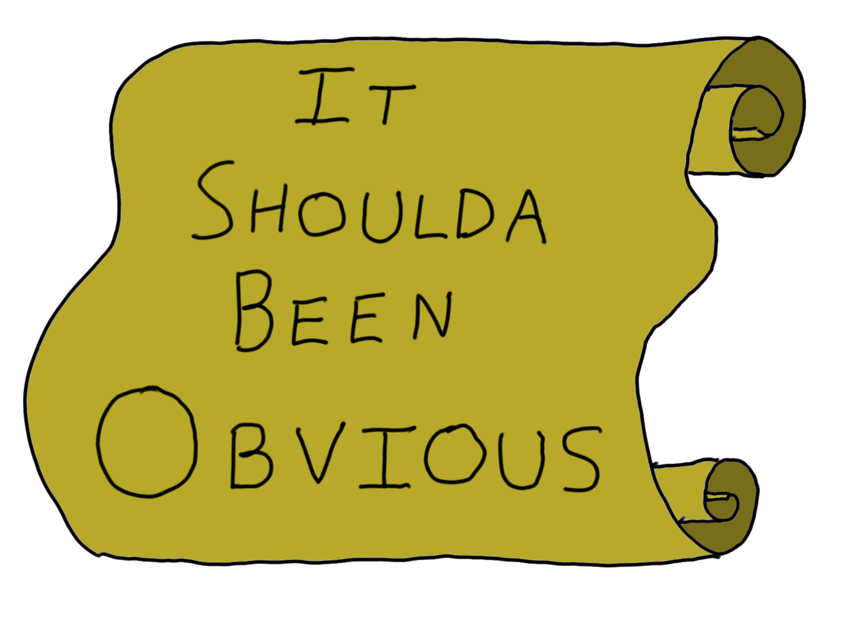

Slide 113
Hindsight Bias

Slide 114
Fischhoff and Beyth, 1975
Notes:
STUDY was in 1970s – visit was in 1972

Slide 115
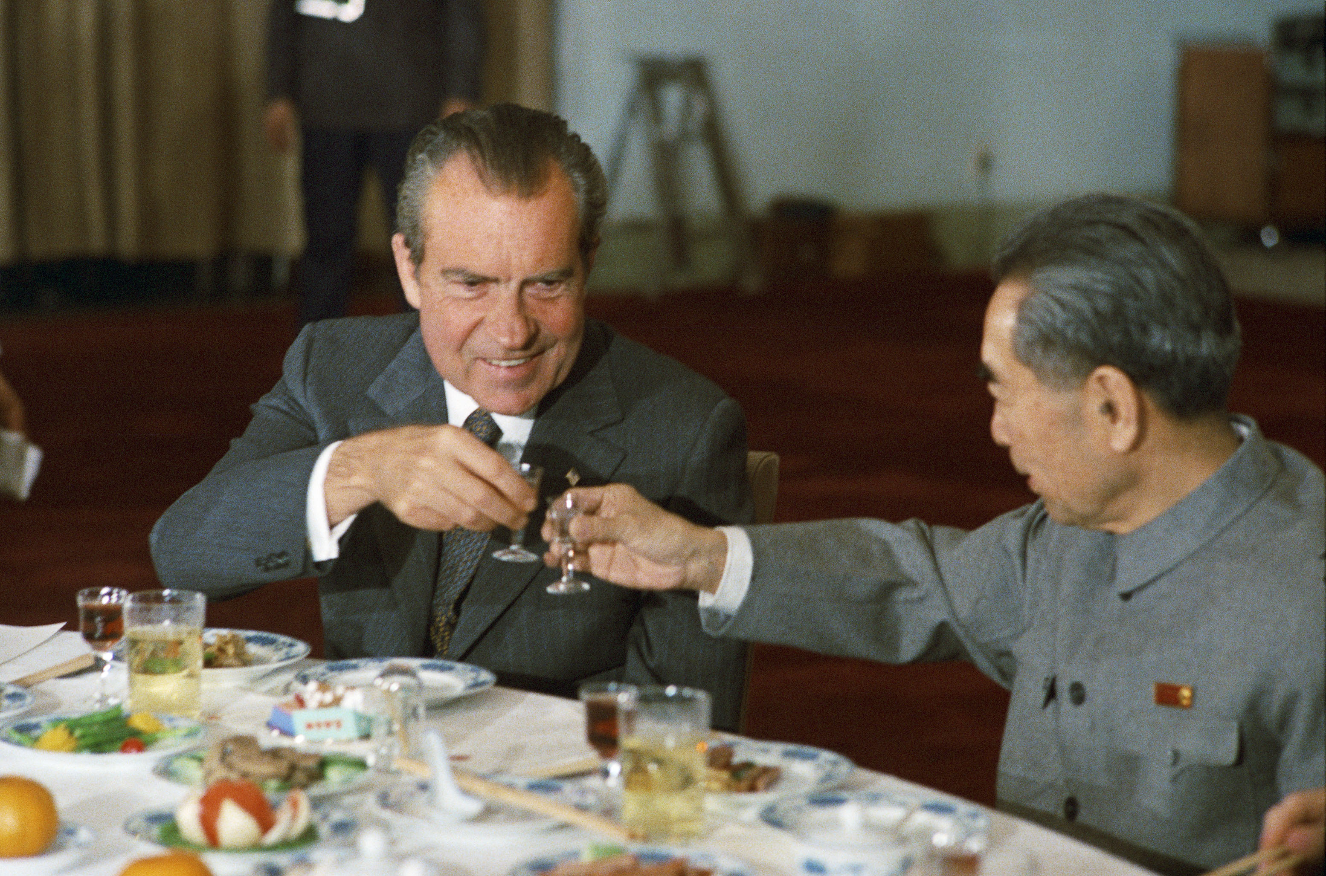

Slide 116
The USA will establish a permanent diplomatic mission in Peking, but not grant diplomatic recognition.
President Nixon will meet Mao at least once.
President Nixon will announce that his trip was successful.

Slide 117
People retroactively inflated their original estimate of the events that actually happened

Slide 118
What is Noodles doing?

Slide 119
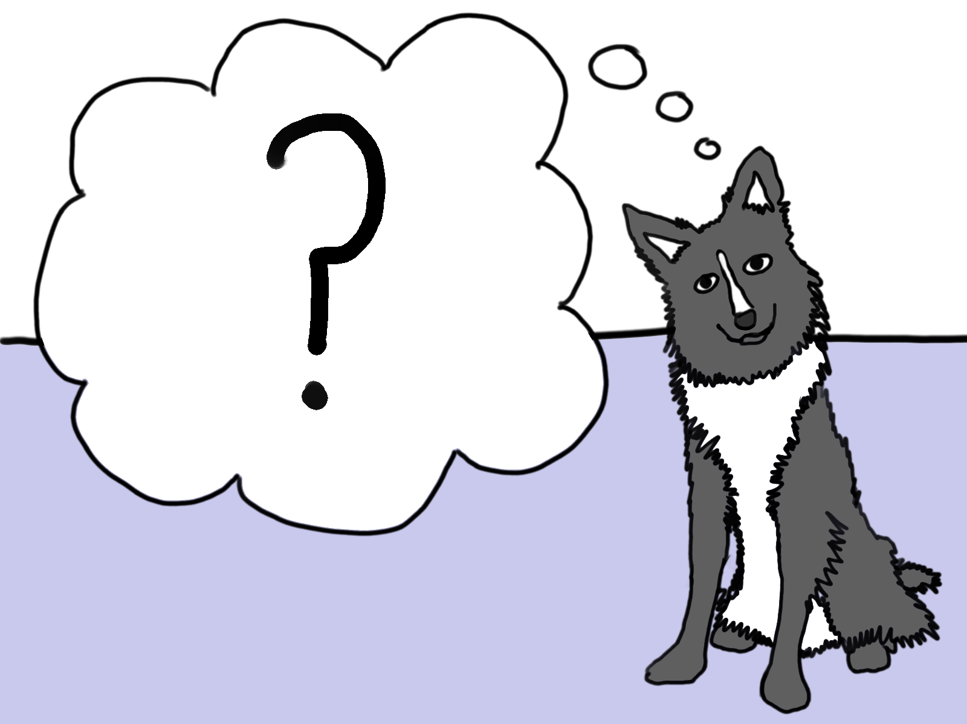
Notes:
Before an event Noodles has to guesstimate based on the model he keeps

Slide 120
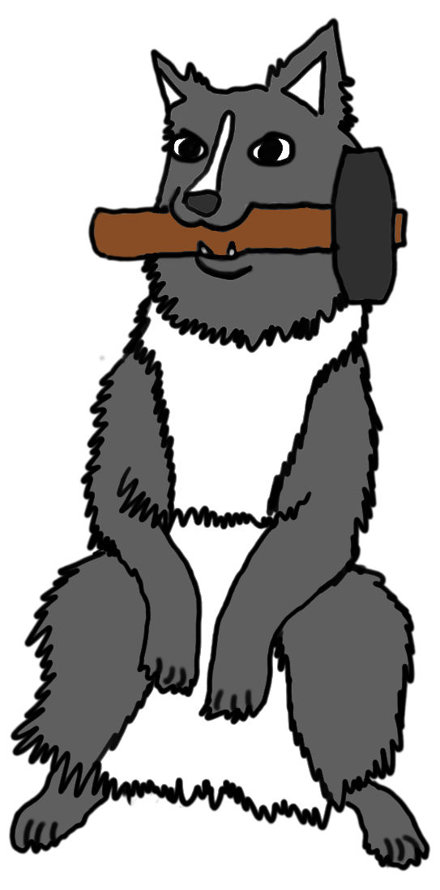
Notes:
AFTER the event he has to Reconstruct those probabilities

Slide 121
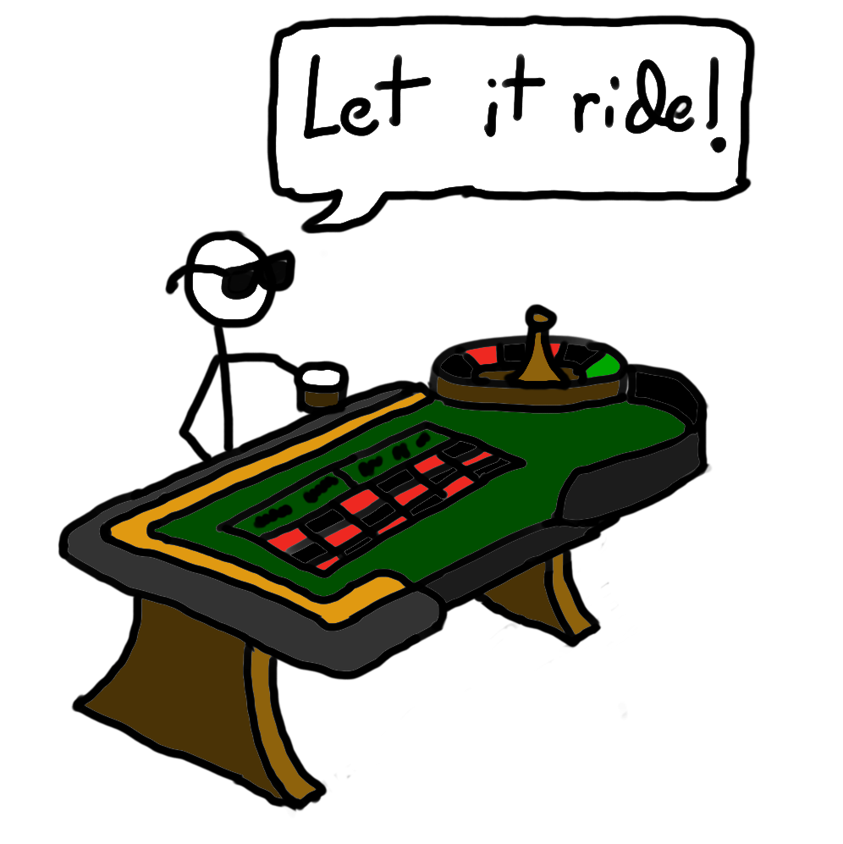
Notes:
Also humans are terrible at probability!

Slide 122
What can you do?

Slide 123
Record everything!
Keep public records of meetings and action items. The more note-taking and note takers the better.
Keep telling yourself: “If I’d known it then, I’d have acted on it then.”

Slide 124
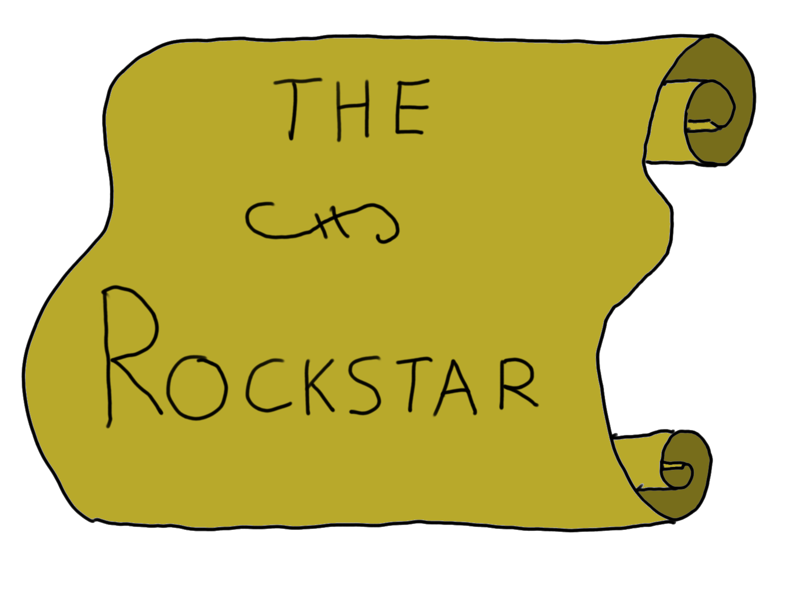

Slide 125
Egocentric Bias

Slide 126
Ross, Greene and House, 1977

Slide 127
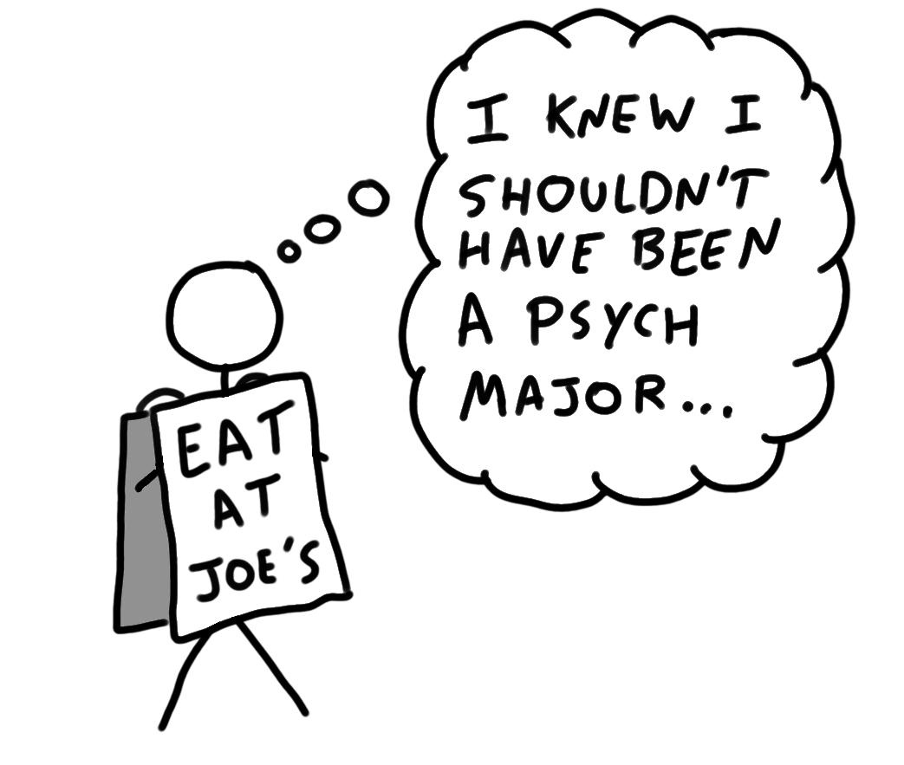

Slide 128
How many of your peers would do this?

Slide 129
Those who agreed to do it thought
58.3% would agree
Those who did not agree to do it thought
70.3%
would not agree

Slide 130
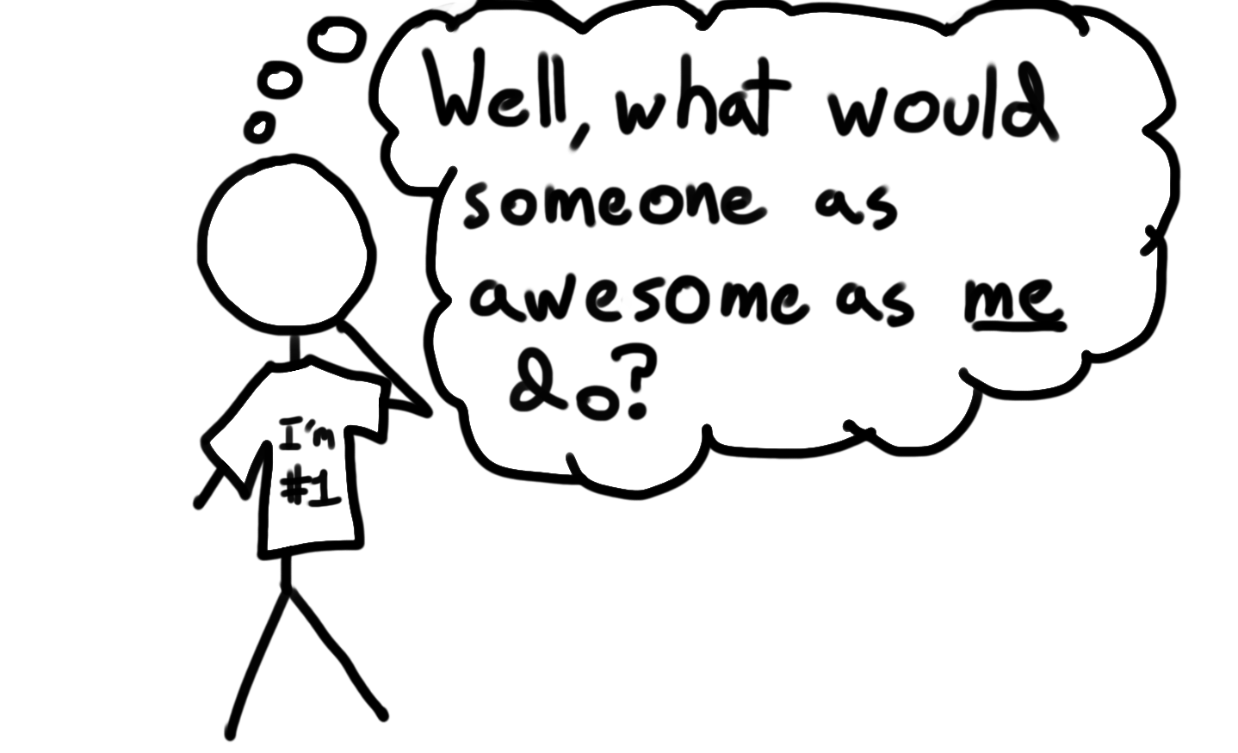
Notes:
We tend to think from our own perspective

Slide 131
False Consensus Effect

Slide 132
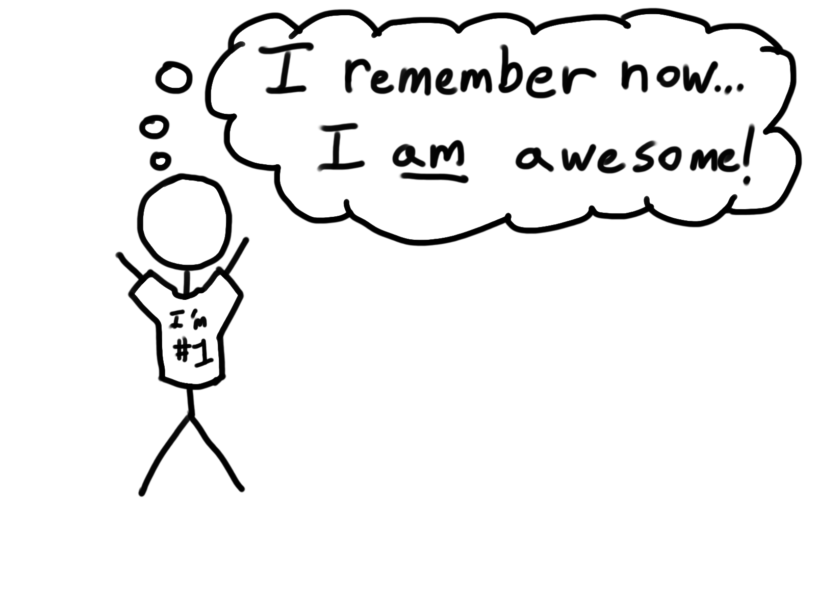
Notes:
We tend to REMEMBER from our own perspective, too

Slide 133
Think about group projects

Slide 134
What is Noodles doing?

Slide 135
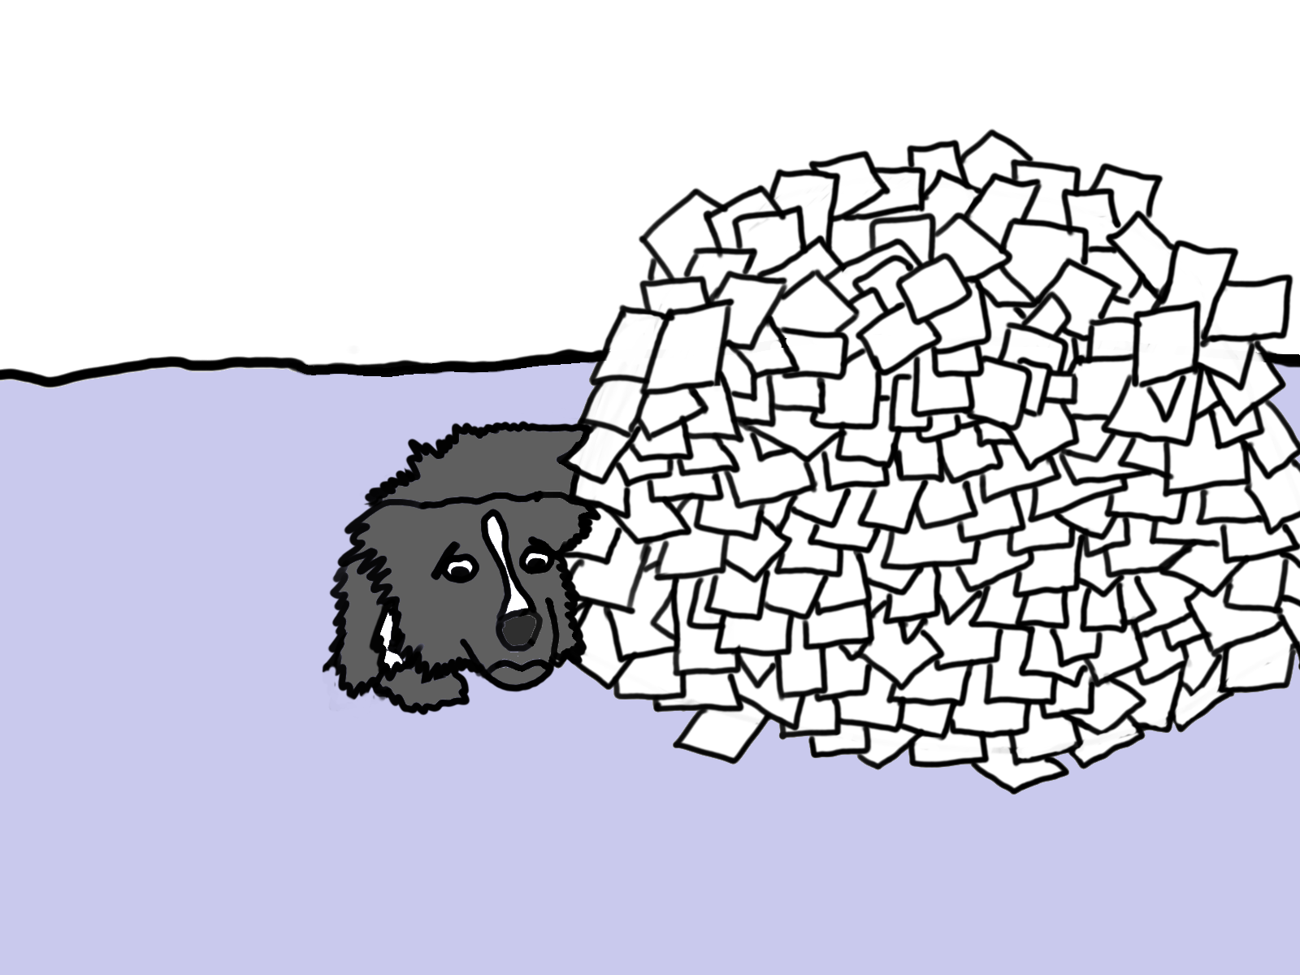

Slide 136
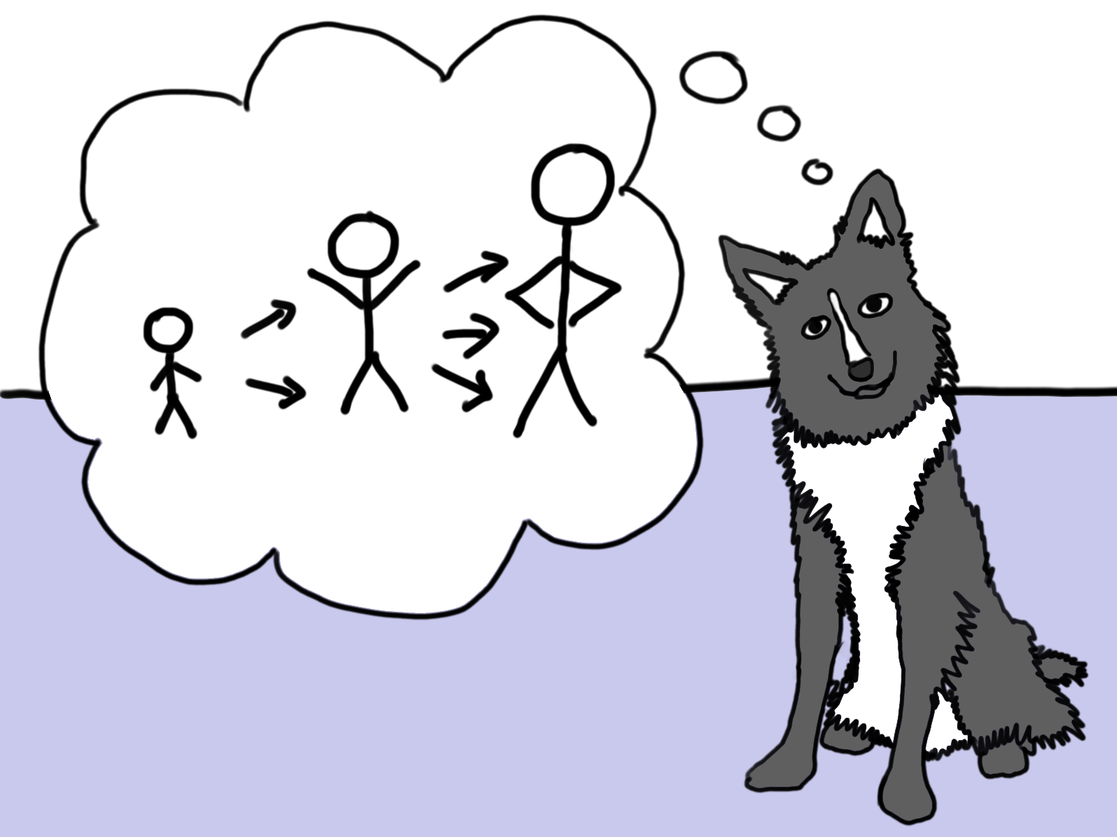

Slide 137
What can you do?

Slide 138
Give people a purpose

Slide 139
The stronger your team is – the more they identify with a common goal – the less egocentric bias will matter in the team.
The stronger your company is…

Slide 140
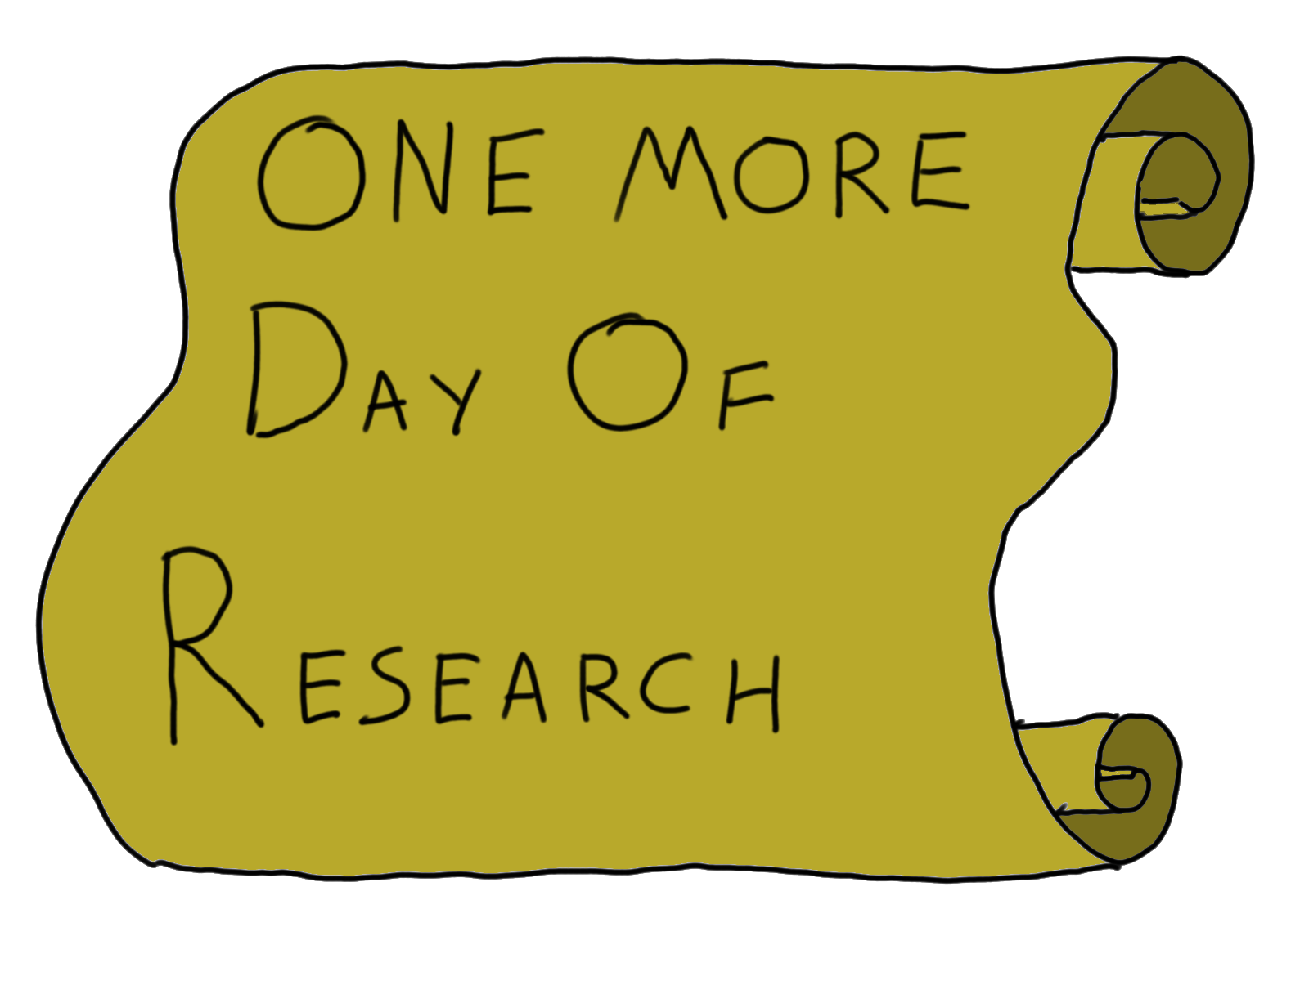

Slide 141
Bias Blind Spot

Slide 142
Bias Bias

Slide 143
Illusion of superiority

Slide 144
Lake Wobegon
“Where all the women are strong, all the men are good looking, and all the children are above average."

Slide 145
University of Nebraska faculty survey, 1977
68% rated themselves in the top 25%
More than 90% rated themselves above average

Slide 146
You think you are less biased than you are
… And I’ve just spent an hour giving you justification for that

Slide 147
What can you do?

Slide 148
Teach your team about biases – then keep each other honest
“Bias Buddies™”

Slide 149
Let’s wrap this up

Slide 150
Remember! your primary tool is awareness

Slide 151


Slide 152
Actually talk to other people and find out what they value, and what their external circumstances are. (Narrative Bias, Attribution Errors)
Be empathetic towards other people. (Narrative Bias, Attribution Errors)
Remember that the farther an action is from its effects, the less likely it is that your intuition will connect the dots. (Narrative Bias)
Recast people in your outgroups as your ally. (Attribution Errors, Egocentric Bias)
Record opinions before discussion. (Anchoring and Framing Effects)
Vote on topics to discuss. (Anchoring and Framing Effects)
Focus on the things your team can actually control. (Illusion of Control)
Record your team’s decisions, and what information led you to make them. (Hindsight Bias)
Make sure you and your team know your purpose. (Egocentric Bias)
Build trust in your team and become Bias Buddies™. (Bias Bias)

Slide 153


Slide 154
Be satisfied with explanations of events that blame a person. (Narrative Bias)
Fall prey to the post hoc ergo propter hoc fallacy. (Narrative Bias)
Use frames that are strictly positive or negative when proposing ideas. (Framing Effect)
Try to use complex processes or even your knowledge of biases to manipulate people. (Illusion of Control)
Feel bad because you “should have known” something. (Hindsight Bias)
Procrastinate by continuing to seek more information when you don’t need it. (Information Bias)
Make decisions under pressure! Cognitive load makes you more likely to accept System 1’s output without checking it first. (All Cognitive Biases)

Slide 155


Slide 156

Thanks!
Arthur Doler
@arthurdoler
arthurdoler@gmail.com
Slides: http://bit.ly/2vttrTx
Handout: http://bit.ly/2viy7en

Slide 157
Resources
Thinking, Fast and Slow – Daniel Kahneman
You Are Not So Smart – David McRaney
You Are Now Less Dumb – David McRaney
The Hidden Brain – Shankar Vedantam

Slide 158
The Wikipedia list of Cognitive Biases
Chase down the primary sources! A lot of the studies are in PDF format for free!
Resources

